Slide 1
How to Use The OCAN
Quality Toolkit Webinar

Slide 2
WebEx Housekeeping Tips
• Move your mouse occasionally
• Put your speaker phone on mute (*6)
• Do not put your phone on hold
• Your screen should be showing a Participants panel and Chat panel
• If not, go into the panel menu by clicking the green tab
• Then click on the participants icon to open the participant box and the chat icon to open the chat box
• To ask a question during the WebEx, write it out in the Chat box and select “send to all participants”

Slide 3
Quality Background
“Common standards for information management and clinical care can help improve the quality and consistency of services across the province”*
Many organizations are working on quality improvement plans to meet standards set out by the Excellent Care for All Act (2010)
    Decisions about client care are based on the best evidence and standards
* Every Door is the Right Door, The Provincial 10-year Mental Health Strategy (2009),

Slide 4
Where Does OCAN Fit In?
OCAN is one source that can contribute to your organization’s quality improvement efforts
Goal of the toolkit: “quality” is looked at in two ways:
The OCAN information is of good quality
The OCAN can inform HSP quality goals to improve service planning and delivery

Slide 5
Objectives of this session
To assess the processes that HSPs currently use to:
  Monitor the quality of OCANs
  Utilize OCAN information in service delivery and planning at various levels
To learn about processes that other HSPs are using
To think about ways you may want to build on your current processes
To walk away with tools to put ideas into action

Slide 6
OCAN Quality Toolkit
Toolkit intent:
  Using real examples, the toolkit provides practical and meaningful ways to improve the quality and utility of OCAN information
Toolkit measure of success:
  Interested HSPs “walk away” with a plan to implement at least one strategy around monitoring OCAN quality and using OCAN information on a day-to-day basis to benefit consumers served
What’s in the toolkit:
  Framework
  Sector examples
  Worksheets

Slide 7
OCAN Quality Toolkit continued

Slide 8
Input
Processes to improve the quality of OCANs

Slide 9
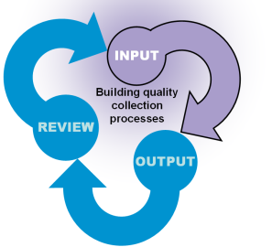






Input: Example Strategies
One on One support
Consistent approach for
Documenting free text
Case Studies
Process for OCANs to
Get done on time
Using standardized reports
to identify errors
Forming a Committee

Slide 10

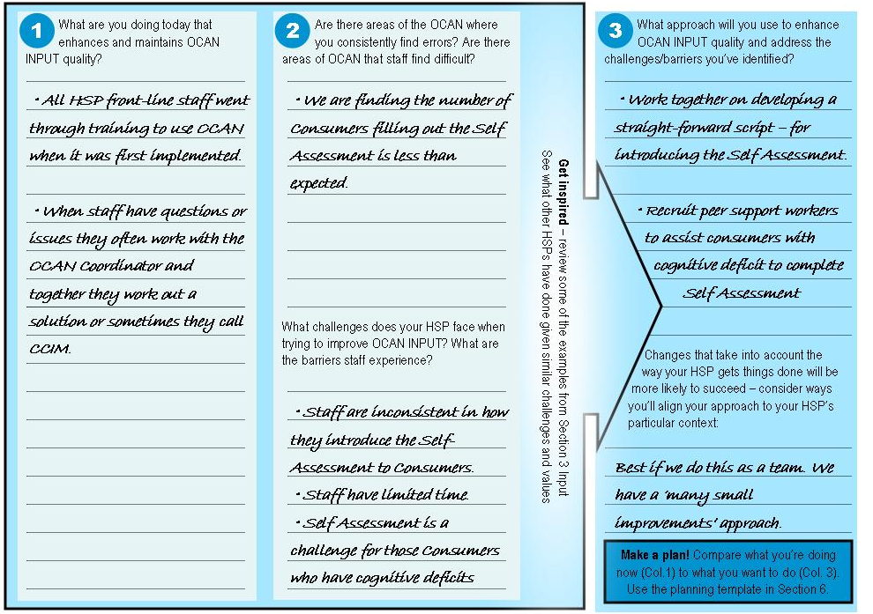
Input: Worksheet

Slide 11
Outputs
Identifying OCAN information that informs your quality efforts

Slide 12
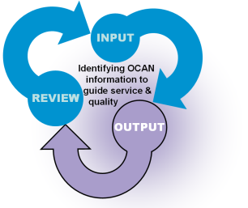




Output: Example Strategies
Optimal Referral | Specify | Actual Referral | Specify
Drop down list | Name of optimal referral | Drop down list | Name of actual referral
Priority | Domain | Action
 | Accommodation | Submit application for supported housing
  Summary of Actions and Summary of Referrals
  Level of Agreement – Consumers and Staff
  Key Demographics and Issues for HSP’s Client group
Accommodation
Food
Looking After the Home
Self Care
Daytime Activities
  Change in Needs over Time
  Consumer Self-Assessment Completion Rate
  Areas of Need

Slide 13
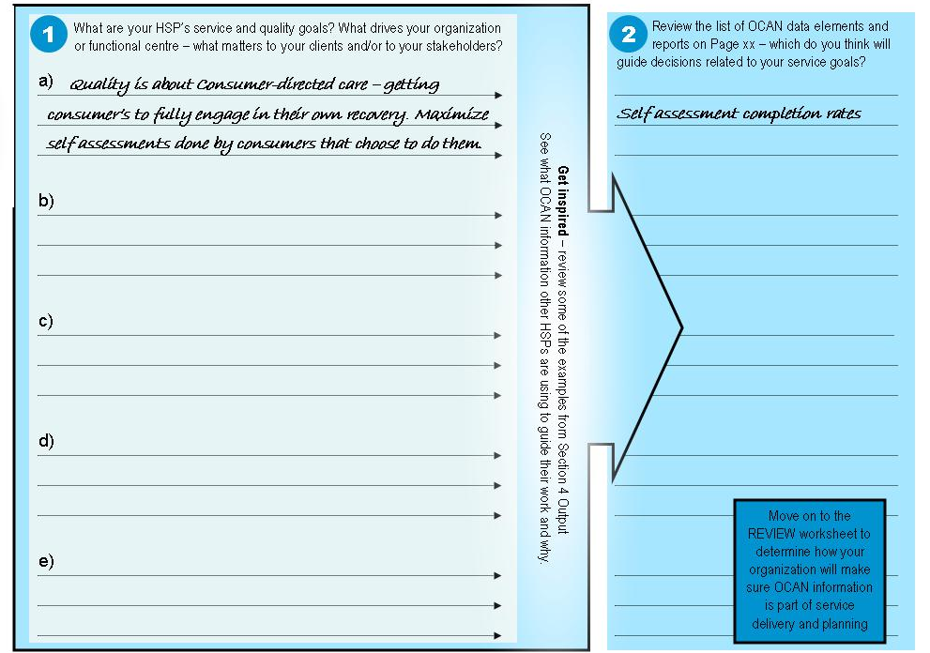
Output: Worksheet

Slide 14
Review
How do you review the outputs to contribute to improving service quality

Slide 15
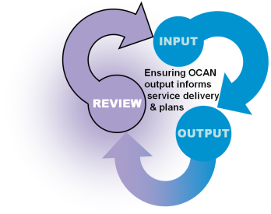
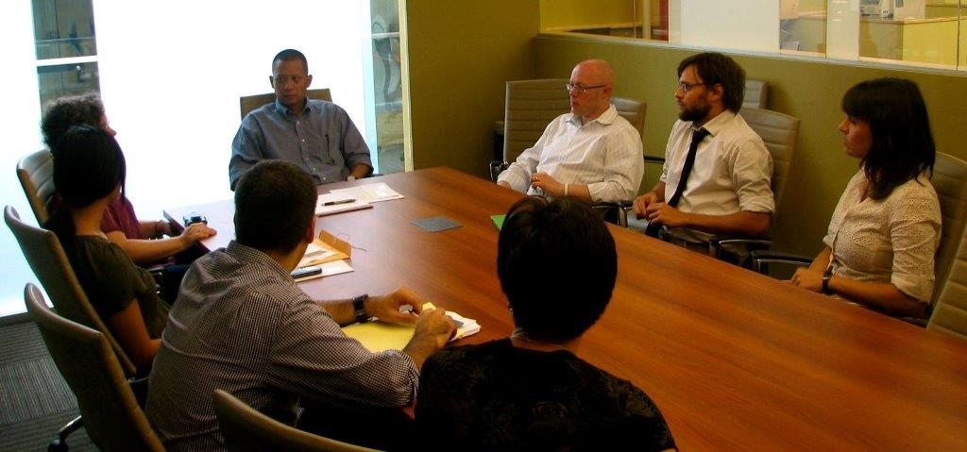
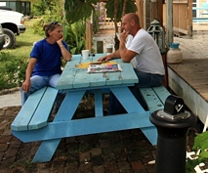
Review: Example Strategies
Gives examples of processes to regularly review the OCAN information to inform service delivery and decision-making
  Consumer/Worker Meetings
  Supervision Meetings
  Direct Service Team Meetings/Case Conferences
  Program Planning Meetings
  HSP Strategic Level Planning and Evaluation

Slide 16

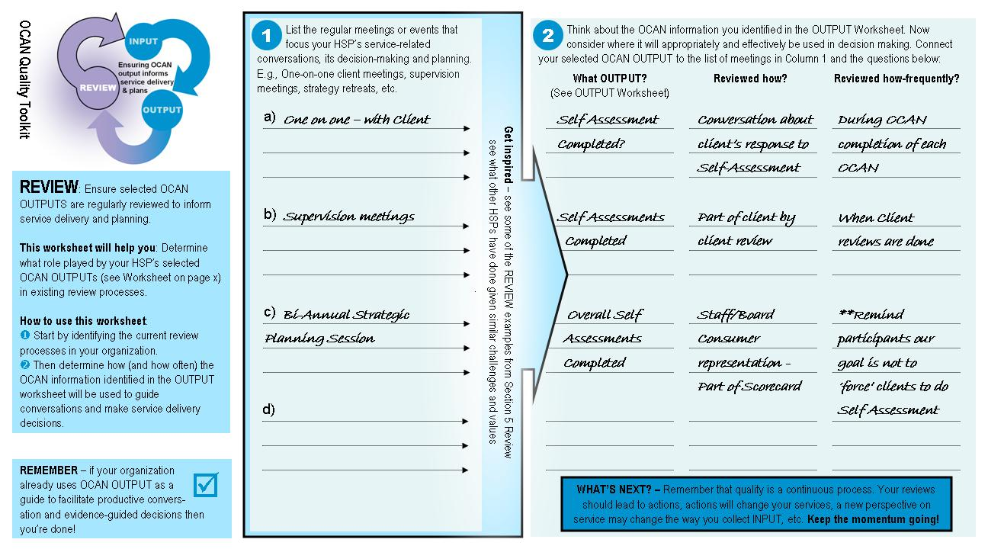
Review: Worksheet

Slide 17
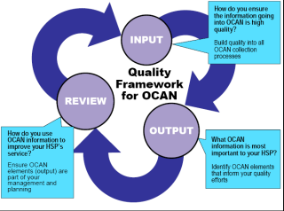
Where does it start?
You can start anywhere within the framework
Take an approach that fits with your organization’s processes
Examples:
Summary of Actions used regularly – Output and Review
Planned refresher training– Input
Staff quality improvement meeting – Review

Slide 18
Where does it end?
It doesn’t end – continuous improvement process
Build it into ongoing operational processes
Examples of existing processes you may have:
Consumer surveys or focus groups
Quality Assurance Committee
Regular team meetings

Slide 19
Section 6: Next Steps
Put a plan of action in place

Slide 20
Acknowledgement
CMH sector provided advice and input, including representatives from:
  Canadian Mental Health Association (CMHA) – Champlain East
  Canadian Mental Health Association (CMHA) – Toronto Branch
  Enaahtig Healing Lodge & Learning Centre
  Frontenac Community Mental Health and Addiction Services
  Oak Centre Clubhouse
  People for Equal Partnership (PEP)
  Supportive Housing in Peel
  Trillium Health Centre

Slide 21
Questions or Feedback
If you have any questions or comments, please contact:
        Support Centre
        Telephone: 1-866-909-5600
        Website: www.ccim.on.ca
        E-mail: cmhcap@ccim.on.ca

Slide 22
Website to download the materials
  https://www.ccim.on.ca/

