Slide 1
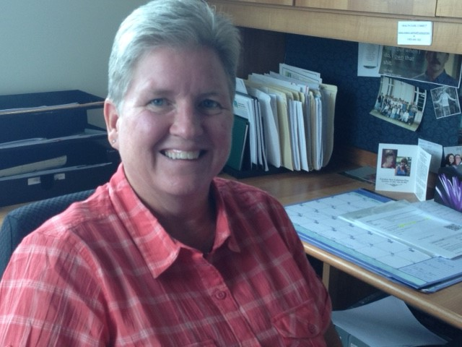
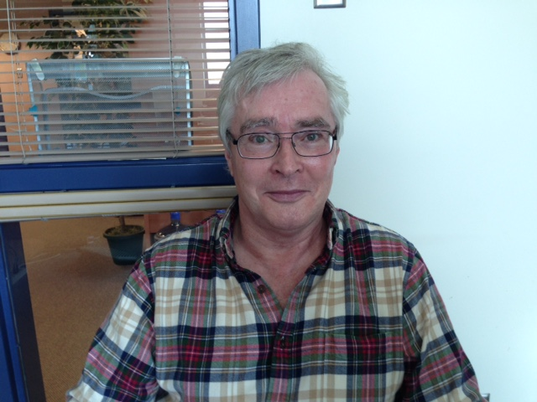
OCAN THINK TANK
June 21, 2018
Debra MacDougall-Pultz
Robert Lillie

Slide 2
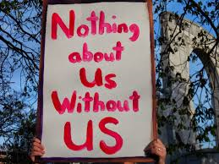
Our Motto at CMHA-CT
We include our clients in all projects, workshops, trainings and committees as possible.

Slide 3
A Client’s Perspective
CMHA-CT highly encourages client involvement, and being an “Ambassador” is just one way of doing this.
The Ambassadors was the name selected by the clients sitting on the committee to reflect their role.
The Ambassadors are composed of clients and a project lead who met bi-weekly and provided information and feedback on how our agency could become more Recovery Oriented.

Slide 4
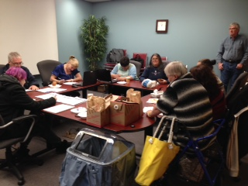
Our CMHA-CT Ambassadors
In this picture, our Ambassadors are assisting clients to fill out a Recovery Self-Assessment. They also assist with WRAP and volunteer at CMHA events when needed.

Slide 5
A client’s perspective cont’d
Clients sat on task committees for the Recovery Change Program – eg: Service Recipient Task Group, Outcome Measures, Service Guide, Documentation Committee, Peer Support Core Competencies etc. – 10 Task groups in total.
Volunteering - I sat on our Documentation Committee, which eventually became part of the Excellence in Quality Improvement Project (E-QIP)
The committee and being an Ambassador gave me a sense of purpose and usefulness.

Slide 6
Cochrane-Timiskaming motto
Notes:
Our job at CMHA-CT is to help people in living a meaningful life to the fullest. Our documentation records this journey and holds us accountable to this.

Slide 7
OCAN and Recovery Values
Confidence that everyone has the potential to change and live a more meaningful life.
Grounding all record keeping in each individual client’s needs & goals.
Actively seek out and document strengths.
OCAN and Recovery Plan sets people up for success.
Client is in the driver’s seat / priorities.
Collaboration between client and staff throughout OCAN assessments and recovery process
Notes:
Script:
Rob we will speak to both items in the circle – Growth and Relationships – OCAN setting people up for success and Client/staff collaboration throughout OCAN Assessments.
Here are some ways that DORR supports our Recovery Values.
DORR keeps us person-centred by connecting all documentation to individual client needs & goals
In the assessment conversations and development of the Recovery Plan, we communicate hope through our confidence that everyone has the potential to change and live a more meaningful life
DORR encourages us to actively seek out and document strengths which helps uncover the potential qualities and resources that everyone possesses to recover
The Goals and Milestones in the Recovery Plan build on this hope and set people up for success as they experience their own ability to achieve.
Collaboration between client and staff throughout the DORR process is grounded in our knowledge that relationships are key to recovery
Throughout DORR, the client is in the driver’s seat making the choices as to what priorities are important
Our Recovery-Oriented Values.
Please click to move to the next slide.

Slide 8
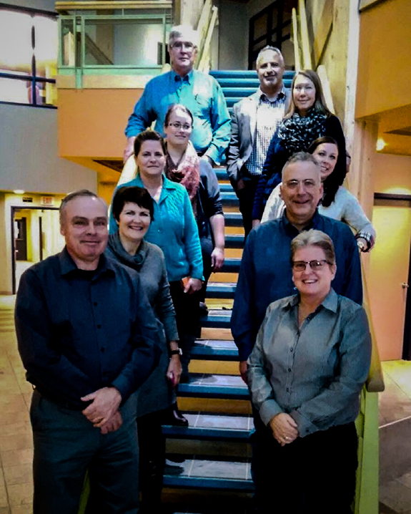
Excellence in Quality Improvement Team (E-QIP)
Notes:
What initially started as our documentation committee, grew into the EQIP Project Committee. The AIM was to get staff to complete more OCANs and Recovery plans, and more importantly, in collaboration with their clients.

Slide 9
A client’s perspective continued..
Felt I was contributing to positive changes in the organization.
An example of a change that we were responsible for, was the use of the word client as opposed to Patient, Service Recipient or Consumer.
It was reassuring that my viewpoint was being included and I could communicate potential changes to other clients.
It felt good that my ideas were elicited and valued by the chair of our committee.

Slide 10
A client’s perspective continued…
Clients also co-facilitate WRAP groups with staff who also have lived experience
I found the OCAN review useful as a form of encouragement and hope, when even small changes were noted.
I was depressed when I met with my worker so found it helpful when we filled the OCAN in together.

Slide 11
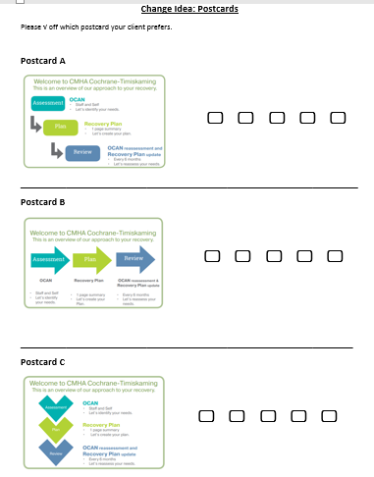
Post Cards we tested as a PDSA
Notes:
Here are the 3 post cards developed as a Change Idea and had 45 clients vote on. The people who voted this in were clients of our Case Management Pilot Team.
We were originally testing to see if those clients felt doing the Recovery Plan was useful in their Recovery Journey, but then found quite a few hadn’t even had OCAN done yet, so we took a step back and revisited our Project Aim Statement.

Slide 12
Post Card given to Clients at CMHA-CT
Notes:
Our Aim is to have all clients that walk through our door, leave with this post card.

Slide 13
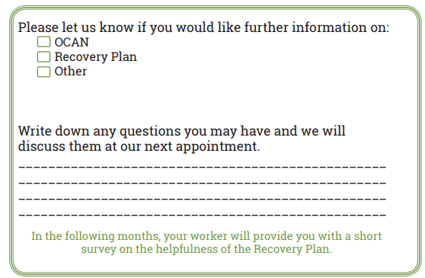
Post Card given to Clients at CMHA-CT continued..
Notes:
This is the back of the postcard, and we encourage clients to fill this out and take it with them. They can bring it back upon next visit should they have any questions or concerns, or if they would just like more information.

Slide 14
Bookmarks for Staff: OCAN Domains and use in Progress Notes
Domains
Progress Notes
Notes:
We created this bookmark in order to assist clients and staff fill out the Recovery Plan after completing the OCAN. These are the OCAN Domains, and DARE is our documentation process. Data, Action, Recovery Plan, Evaluation. Clients stated they found this useful. The numbers of OCAN’s and Recovery plans done increased significantly.

Slide 15
In Conclusion
Between securing a new data base and helping staff understand the importance that OCAN’s and Recovery Plans have on a client’s recovery journey, I have uploaded 100’s of OCAN’s to the IAR, so HUGE increase (Since May 2017).
In the EQIP project, 100% of clients stated that the OCAN was a useful tool in assisting in their recovery.
The projects we have been involved in through Health Quality Ontario - EQIP and IDEAS projects, have certainly paved the way in terms of helping us move forward in our quality improvement work.
We would not have been able to progress this far without the help of our dedicated client volunteers/ambassadors who are present at all of our committee meetings, trainings and conferences. Kudos to everyone!
Notes:
Rob – objectivity, pragmatism and grammatical expert and Louis for his expertise and dedication.
Also thank Kathy – integral part of this team, and Co-lead

Slide 16
for listening!
Notes:
Thank you very much for your time, we hope this was helpful.

Slide 17
End of presentation

Slide 18
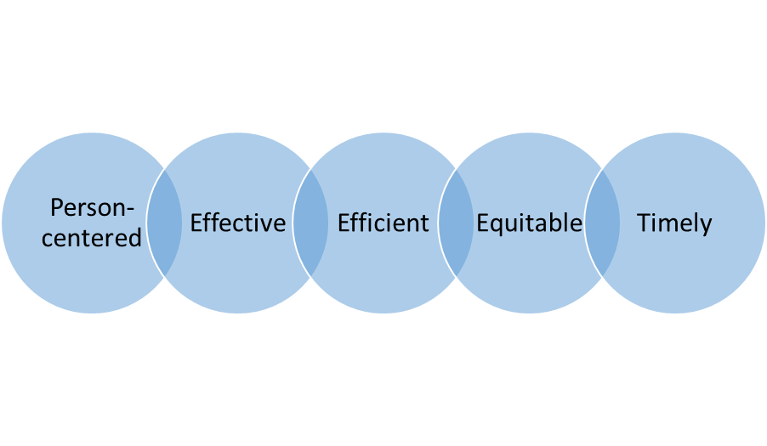
Appendix: Documentation Guided by OCAN Leading to Quality Improvement
Problem:
Baseline Data (2016) showed that 100% of clients with a Recovery Plan find it helpful, but 45% of clients don’t have a Recovery Plan
Aim
Increase % of clients with a Recovery Plan
Reassess with OCAN every 6 months
Update Recovery Plan every 6 months
Strategy:
Developed a documentation process using OCAN domains:
Domain Oriented Recovery Record (DORR)
Assessment —> Planning —> Progress Notes
Use documentation in practice to support client care
Involve clients and staff in the QI process
DORR incorporates Quality Dimensions:
Effective Change Idea Products:
Bookmarks for Staff
Postcard for Clients and Staff
Results (2018)
☺ 90% of clients have a Recovery Plan
and report that it’s helpful in meeting their recovery goals
Support
Excellence through Quality Improvement Project
(E-QIP) resources and coaching
Community Care Information Management (CCIM) resources to identify guidelines for OCAN use

