Slide 1
Using the Ontario Common Assessment of Need (OCAN) in Quality Improvement (QI):
The OCAN QI Network
May 2020

Slide 2
Presenters
Fedora Romita - Administrator – Consumer/Survivor Initiative of Niagara
Linda Saunders– QI Coach, CMHA Ontario Division
Laura Daly-Trottier – QI Coach, CMHA Ontario Division

Slide 3
The Excellence through Quality Improvement Project
(E-QIP)
E-QIP is led by Addictions & Mental Health Ontario (AMHO), Canadian Mental Health Association (CMHA), Ontario and is delivered in close partnership with Ontario Health(OH) and the Provincial System Support Program (PSSP) at the Centre for Addiction and Mental Health (CAMH)to promote and support quality improvement (QI) in the community mental health and addiction sector.
E-QIP is based on the sector’s existing commitment to providing high quality, person-centered care to individuals and families.

Slide 4
What is Quality Improvement (QI) in health care?
Quality Improvement is a systematic approach to making changes that lead to better client outcomes (health), stronger system performance (care) and enhanced professional development. It draws on the combined and continuous efforts of all stakeholders — health care professionals, clients and their families, researchers, planners and educators — to make better and sustained improvements.
Good
Better
Best
Source:
Health Quality Ontario - Quality Improvement page
Paul Batalden and Frank Davidoff. What is "quality improvement" and how can it transform healthcare? Qual Saf Health Care. 2007 Feb; 16(1): 2–3. (PubMed)
IDEAS Glossary: http://online.ideasontario.ca/terms/quality-improvement/
Notes:
QI SIMPLY DEFINED IS A METHOD OF CONTINUOUSLY FINDING BETTER WAYS TO PROVIDE BETTER PATIENT CARE AND SERVICE
PRINCIPLES:
Customer focused (patient)
Continuous improvement of all processes
Involvement of all
Use of data and knowledge to improve decision making
WHAT QI IS NOT IS “QUALITY CONTROL”. i.e. “looking for bad apples” and and getting rid of them, NOR QUALITY ASSSURANCE, i.e. the process of trying to reduce and/or minimize the factors that lead to errors or defects
AND IT IS NOT RESEARCH where all variation is controlled to allow the testing of one variable; requires large numbers and does not reflect the reality of messy day-to-day life
AIMS for GOOD ENOUGH not PERFECT

Slide 5
The OCAN Network
One of the latest developments of Quality Improvement work in the CMH&A Sector is the province-wide OCAN Network through the Excellence through Quality Improvement Project (E-QIP).
The Network was formed from the OCAN Think Tank
The Network is made up of eleven organizations across the province using Experience-Based Co-Design (a QI tool) to actively engage service users in the QI process.
Our goal is to share our collective learning on the use of OCANs in recovery-oriented practice including pain points (for both service users and staff) and specific changes that were implemented as part of the PDSA process in this QI project.

Slide 6















Our OCAN Network Team
  Participating Organizations:
      CMHA Cochrane Timiskaming
      CMHA HKPR
      CMHA Niagara
      CMHA Simcoe County
      Consumer/Survivor Initiative of Niagara
      COTA
      Gateway of Niagara
      Niagara Region Mental Health
      Nipissing Mental Health
      Oak Centre
      Progress Place
  Clinical and QI support provided by:
    Addiction and Mental Health Ontario
    Canadian Mental Health Association, Ontario
    Centre for Addiction and Mental Health
    Community Care Information Management

Slide 7
What is OCAN?
The provincial standardized assessment used in the adult community mental health sector
What are your needs in 24 domains?*
What are your hopes, goals & strengths?
Summary of Actions
Priority | Domain | Action
1 | Accommodation | Submit housing application
2 | Physical Health | See nurse practitioner to review treatment plan for diabetes
3 | Psychological Distress | Attend mindfulness to address anxiety
Who are you?
Sociodemographic information
Where do you receive services?
*Focusing services on client identified unmet needs and converting them to met need or no need leads to positive client outcomes
Recovery Plan

Slide 8
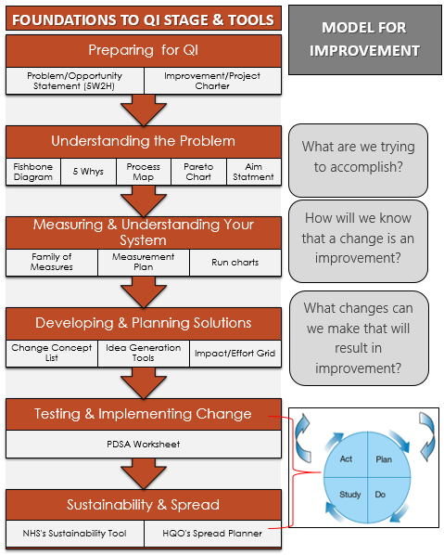
Foundations to Quality Improvement Stage and Tools

Slide 9


Experience Based Design is about designing better experiences…

Slide 10
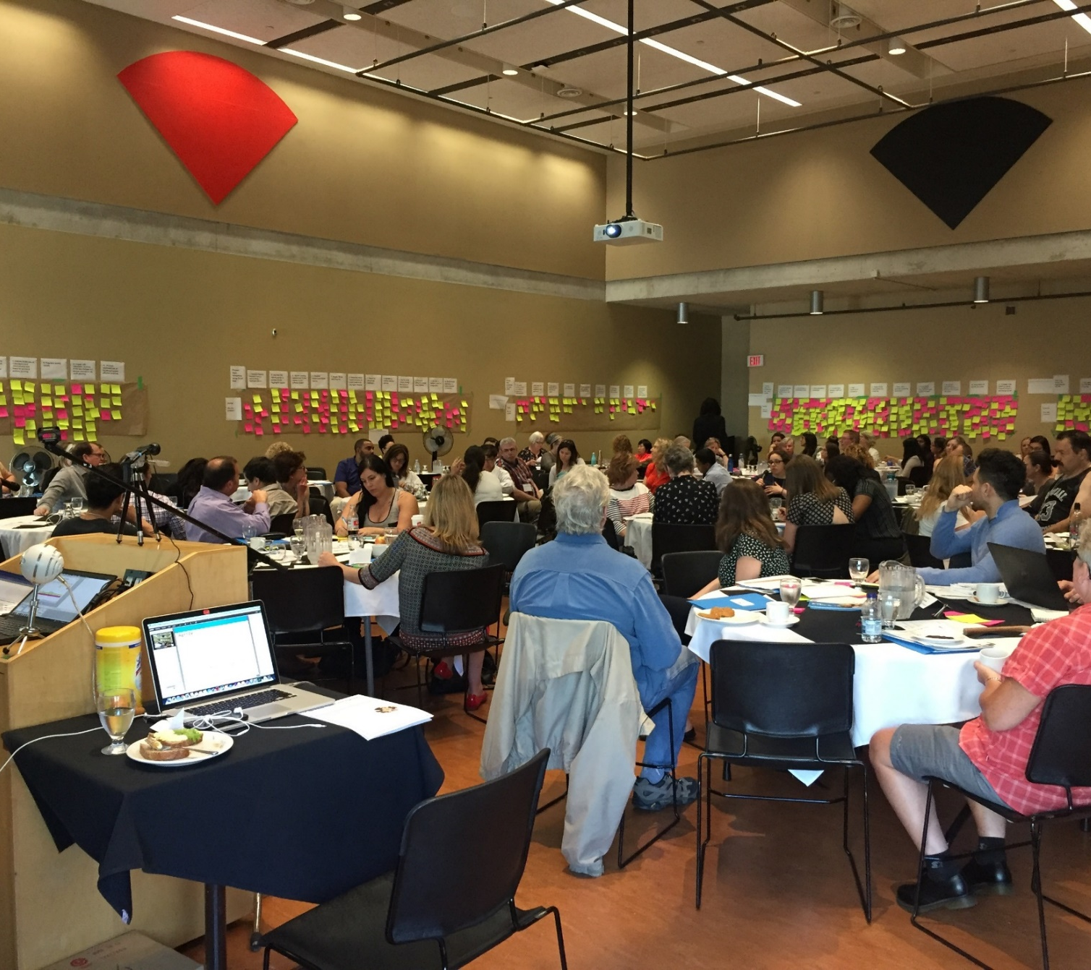
Emotional Mapping Exercise
Providers seeking to understand the experience:
OCAN Think Tank Event 2018
Notes:
LDT 1-10

Slide 11


Problem vs Aim: Two sides of the same coin…
Problem Statement:
Since implementation, a number of organizations have not completed OCANs consistently and/or have not integrated the use of OCAN information in the creation of client recovery plans, including the use of self-assessments so that the client is instrumental in the creation of their recovery plan.
Aim Statement
By December 31, 2020, 90% of clients that participate in the OCAN process will report that the ongoing use of the OCAN in recovery oriented service planning has value in meeting their goals.
Notes:
Linda 11-16

Slide 12
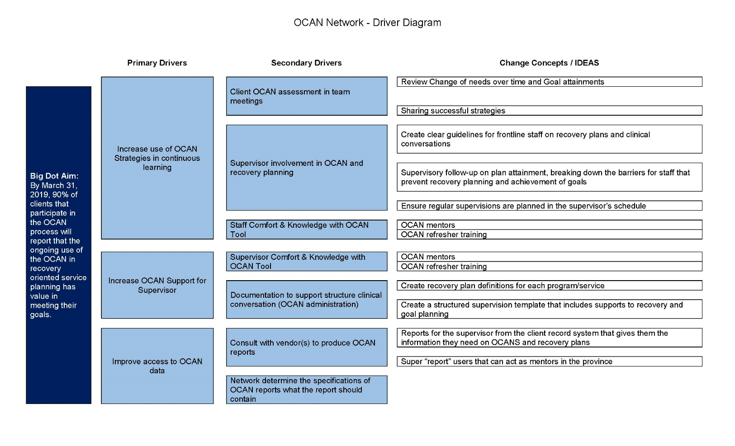
Generation of Change Ideas: Driver Diagram

Slide 13
Change Ideas
  Lack of use of OCAN strategies in continuous learning and ongoing supportive dialogue to enrich the value of recovery planning
  Communication about OCAN and recovery planning as part of:
      Team meetings and supervision
      Case conferences
      Daily dialogue
  Conversations should include:
      Goal attainment
      Change in need over time
      Organizational trends
      Knowledge transfer
      Peer to peer support
      Sharing successful strategies
  Establish OCAN mentors
  OCAN refresher training
  Staff skill development through mentoring on how to engage clients in meaningful conversation about goal/recovery planning (clients are not used to taking action or familiar with the process of change)
  Demonstration from leadership

Slide 14
Change Ideas continued..
  Supervisors do not have a structured way to hold and document clinical conversations with frontline staff as a way to provide guidance and support to staff in helping their client reach their recovery goals
Create a structured supervision template that includes OCAN content to support recovery and goal planning
Ensure regular supervisions are planned in the supervisor’s schedule
Create clear guidelines for frontline staff on OCAN recovery plans and clinical conversations
Create recovery plan definitions for each program/service
Supervisory follow-up on plan attainment, breaking down the barriers for staff that prevent recovery planning and achievement of goals
Reports for the supervisor from the client record system that gives them the information they need on OCANS and recovery plans

Slide 15
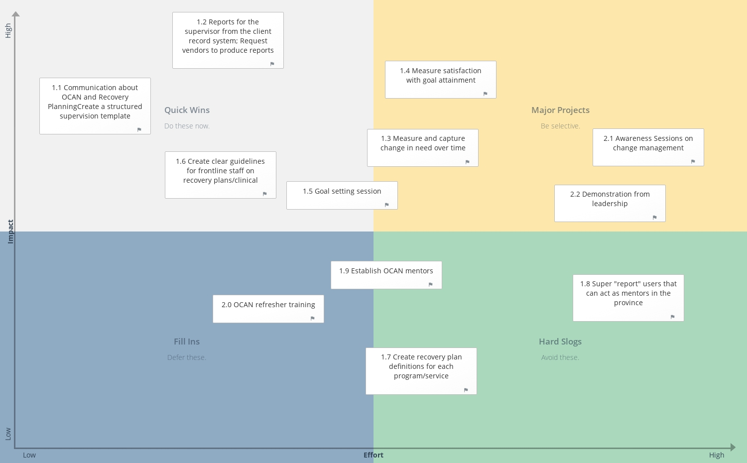
Standardized Tools to Improve Services: A knowledge exchange event

Slide 16
How we’re measuring change
The percentage of staff utilizing OCAN informed recovery plans
The percentage of clients expressing that the OCAN informed recovery plan helped them achieve their goals.
Number of OCANs completed
The increase or decrease (rate of change) of the completion rate over time (i.e. month by month).
Tally of conversations where recovery planning, OCAN and it’s components are discussed
Surveys: Staff and client surveys

Slide 17
OCAN Surveys
Staff Survey Questions:
I find OCAN useful in my role as a worker
I find OCAN useful for the client
I have enough time to complete OCAN ‘s
I regularly use OCAN recovery plans in my day-today work
OCAN content is used to structure client reviews at the appropriate meeting (e.g. supervision, team)
Client Survey Questions:
I know what an OCAN is
OCAN helps me identify and think about my needs
The OCAN has helped me set goals with my worker that are important to me
Updating the OCAN with my worker helps me see my progress (optional)
Using OCAN is helpful to my recovery

