Slide 1
Consent Practices For Common Assessments in IAR
We will be muting everyone from our end
To speak please press (*7)
Your screen should show a Participants panel and a Chat panel
If not, go into the panel menu by clicking the green tab
To ask a question during the WebEx, write it out in the Chat box and select “Send to: Everyone”

Slide 2
Objectives:
To provide information that can assist in the review of your consent management practices for sharing assessments in the Integrated Assessment Record (IAR)
To orient you to available CCIM consent management resources
To learn practical tips from stakeholders that you may want to incorporate into your current processes

Slide 3
Agenda
Background
Local Health Integration Network (LHIN) shares report findings and work with Health Service Provider (HSP) organizations on common assessment and IAR usage
Orientation to CCIM consent management resources using a mock client example
HSP organizations share their experiences and consent management practices

Slide 4
Background

Slide 5
ABOUT
Common Assessments
The internationally recognized standardized clinical assessment tools that are widely used in each of the Community Care Access Centres (CCACs), Community Mental Health (CMH), Community Support Services (CSS), and Long-Term Care Homes (LTCH) sectors collect information about each individual, the services they are receiving, the organization(s) providing the service(s) and their health service providers.
Approximately 1,200 HSP organizations within four community sectors use internationally recognized standardized Clinical Assessment Tools.
Clinical Assessment Tools include: interRAI Preliminary Screener (PS) Assessment Tool, interRAI Community Health Assessment (CHA), Ontario Common Assessment of Need (OCAN), RAI Mental Health (MH) and Resident Assessment Instrument Minimum Data Set (RAI-MDS 2.0).
Notes:
The Total Number of Assessments Submitted to Date measure represents the individual assessments completed by an HSP within a particular sector that are uploaded to the IAR since the initial implementation to the time of data extraction for this report.
The Number of Assessments Submitted in the Last 2 Years measure represents the individual assessments completed by an HSP within a particular sector that are uploaded to the IAR in the last 2 years from the time of the data extraction for this report. This measure provides a snap shot of the volume of assessments performed by HSPs in each sector.
Notes:
The measure ,“Total number of Assessments Submitted (to date)”, represents the number of assessments completed by each HSP within in each sector. These assessments have been uploaded to the IAR since the implementation date to the date of data extraction for this report.
The measure, “Total number of Assessments Submitted (last 2 years)”, represents the number of assessments completed by each HSP within in each sector and have been uploaded to the IAR from 2 years of the date of data extraction for this report. The measure provides a snapshot of the volume of assessments completed by each sector.
Total Number of Assessments
submitted
(to date)
Total Number of Assessments
submitted
(last 2 years)
Assessment Types
Sector
Purpose
InterRAI Contact Assessment
(InterRAI CA)
CCAC
Provides information to support the home care intake process. It records the essential information needed at the time of intake to support decisions regarding the need for more comprehensive assessment, the urgency for home care service provision, and the need for specialized services .
1,376,641
484,251
Resident Assessment Instrument – Home Care (RAI-HC)
Focuses on the patient’s functioning and quality of life by assessing client needs, strengths and preferences. It is generally used for persons who are disabled or have complex conditions and who are seeking or receiving formal health care and supportive services. It is also used to assess persons with chronic or post–acute care needs
1,807,406
542,252
interRAI Preliminary Screener (interRAI PS)
CSS
Provides information to support the intake process. Enables decision-making related to identifying persons who would likely benefit from a comprehensive assessment (interRAI CHA, RAI HC) and records basic information about persons may not require further assessment.
32,601
21,266
interRAI Community Health Assessment (interRAI CHA)
Identifies adults needing supports to prevent or stabilize early functional or health decline. Provides standardized, clinical information to inform decision making, planning, and performance monitoring
74,862
38,591
Ontario Common Assessment of Need (OCAN)
CMH
Supports a consumer centered approach to care through consumer participation in the assessment which contributes to the development of their recovery plan. It is based on the Camberwell Assessment of Need (CAN-C) and additional elements to reflect the consumer population in Ontario.
317,906
151,431
Ontario Common Assessment of Need (OCAN)
CMH
Supports a consumer centered approach to care through consumer participation in the assessment which contributes to the development of their recovery plan. It is based on the Camberwell Assessment of Need (CAN-C) and additional elements to reflect the consumer population in Ontario.
317,906
151,431
Resident Assessment Instrument – Minimum Data Set (RAI-MDS 2.0)
LTCH
Used by all interdisciplinary care team members in long-term care homes to produce care plans, outcome scales, resource allocations and quality indicators
930,470
843,864
Data Source: IAR , as of April 1, 2016

Slide 6
USAGE
Uploading Assessments to IAR
Last Quarter
(Oct. 1 – Dec. 30, 2015)
Current Quarter
(Jan. 1 – Mar. 31, 2016)
Measure: Percentage of HSPs uploading assessments to IAR in the quarter
This measure represents the percentage of HSPs within each sector that have uploaded assessments to IAR.
The LTCH and CCAC sectors are uploading more than 95% of the assessments.
More than 50% of the HSPs in the CMH and CSS sectors are uploading to the IAR. This may be contributed by the varying degree of business processes, software capabilities, and capacities among HSPs.
Note: the denominator for this measure is based on the number of HSPs that have uploaded assessments at least once to the IAR since implementation.
CCAC
100%
100%
100% of HSPs in the CCAC sector uploaded a minimum of 1 assessment this quarter.
61%
CSS
54%
53%
53% of HSPs in the CSS sector uploaded a minimum of 1 assessment in this quarter
CMH
61%
62%
62% of HSPs in the CMH sector uploaded a minimum of 1 assessment in this quarter
LTCH
99%
99 %
99% of HSPs in the LTCH sector uploaded at a minimum of 1 assessment in this quarter
Assessments available for viewing
Last Quarter
(Oct. 1 – Dec. 30, 2015)
Current Quarter
(Jan. 1 – Mar. 31, 2016)
Measure: Percentage of assessments in each sector granted for viewing in IAR in the quarter
This measures represents the percentage of assessments that has been granted by the HSPs and their clients to allow viewing access in the IAR.
Note: the denominator for this measure is based on the number of HSPs that have viewed assessments at least once to the IAR since implementation.
CCAC
96%
96%
96% of the assessments uploaded by CCACs have been granted for viewing
CSS
95%
95%
95% of the assessments uploaded by CSS HSPs have been granted for viewing
CMH
40%
44%
44% of the assessments uploaded by CMH HSPs have been granted for viewing
LTCH
73%
74%
74% of the assessments uploaded by LTCH HSPs have been granted for viewing
Data Source: IAR , as of April 1, 2016

Slide 7
Why A Session On Consent Resources?
The Common Assessment and IAR team:
Received a number of requests regarding consent management resources
Gathered stakeholder feedback that revealed:
Governance, LHINs and HSP organizations have identified that not all completed assessments are uploaded to IAR
Therefore de-identified aggregate reports generated from assessments uploaded to IAR are limited
Consent rates in the CMH sector has decreased over time
Variances in rate of consent amongst HSP organizations

Slide 8
Understanding Consent in IAR?
As part of the assessment standard, all completed assessments should be uploaded to the IAR
The consent you gather from the client determines if an uploaded assessment can be viewed by other participating HSP organizations through the IAR.
If consent is not granted, the assessment is not viewable in the IAR
Uploading all assessments ensures that common assessment data is available to generate de-identified aggregate reports for decision making and planning at various levels

Slide 9
LHIN Message & update

Slide 10
Advancing OCAN
Champlain LHIN experience
Presenter(s): Kevin Barclay
Email: Kevin.Barclay@lhins.on.ca
Event: CCIM OCAN Webinar
Date: June, 2016

Slide 11
Engage key informants
Collaborate on shared assessments
Obligate through MSAAs
Promote continuous development
Participate in the community of practice

Slide 12
Process for using reports and working with the sector
Convened an OCAN working group amongst providers, lead by representatives who work with OCAN and IAR regularly
Initial focus was to develop approaches to collaborating on OCANs for common clients
Renewed focus to explore IAR usage and dialogue about needs identified through OCAN
LHIN review reports as they are provided
Working group reviews highlights of reports as a group to identify opportunities to collaborate on improvements

Slide 13
Perspectives on Champlain MH&A system clients

Slide 14
Individuals served versus IAR assessments 1 leading agency

Slide 15
Range of consent (excludes leading agency)
Only uploading full consents?
Reasonable expectations?
Opportunity for improvement?

Slide 16
Range of consent (includes leading agency)
Representative needs?

Slide 17
Range of Representativeness
Equal effort?
Representative?

Slide 18
Next Steps
Promote the benefits of exploring client identified needs as a way to improve services and systems
Explore with individual agencies the barriers to upload
Support the development of improvement plans to assist agencies in meeting MSAA obligations
Ultimately, once uploads are consistent and comprehensive, facilitate collaboration on common clients through expanded viewing within OCAN and across other data sets.

Slide 19
Consent Management Resources

Slide 20
Consent Management Resources
Provide an opportunity to better understand resources available to support how you inform your clients
Purpose:
To demonstrate what customizable tools are available and how they can be incorporated into the day to day workflow
To consider what methods you use now and if you would like to modify your current approach

Slide 21
Mock Client Example:
Role:
Client: Betty
Case Coordinator: Mohammed
Demonstration:
Walk through some of the customizable tools available on the CCIM website that can be used to inform Betty about privacy and consent
Show some examples of consent directives - IAR screen shots

Slide 22
Mock Client Example:
Informing Betty:
Customizable resources available:
Script
(download here)
Brochure
(download here)
Poster
(download here)
Consent Form
(download here)

Slide 23
Mock Client Example
Consent Directives
IAR Screenshots:
Betty doesn’t want this assessment shared
Betty doesn’t want any assessments shared

Slide 24
HSP Organizations Share Their Practices

Slide 25
Consent Management Process at HopeGreyBruce Mental Health and Addictions Services
Elizabeth Thomas
EThomas@hopegb.org
Community Network Support Team

Slide 26
Who We Are
HopeGreyBruce Mental Health and Addictions Services is a non-profit charitable organization established in 1985 to provide community mental health and addictions services across Grey-Bruce
We currently operate 2 addictions programs and 8 community mental health programs.
We also host 2 multi-agency community mental health teams

Slide 27
Process for Obtaining Client Consent Directive
All workers receive training in OCAN consent practices and procedures through orientation and OCAN refresher training (one trainer – consistent message)
At the first face to face appointment with a client; the worker reviews the purpose of the OCAN and IAR with the client. The “Privacy and Your Assessment” brochure developed by CCIM assists with this process and is given to each client
CCIM’s ‘script’ is utilized as the foundation for this conversation

Slide 28
Process Continued…
The options are carefully reviewed with the client
The client selects what they are comfortable with and signs the consent form accordingly
The consent form was generated by CCIM but it has been internally adapted
Consent to share (or not share) is also recorded on a ‘Consent Log’ that is attached to each client record

Slide 29
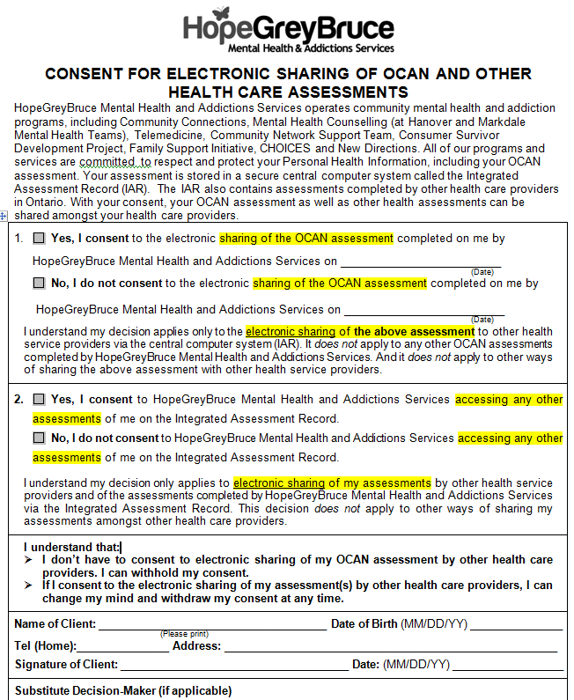
Consent Form

Slide 30
Observations/Tips
Why do some workers have high rates of consent to share and others do not?
Workers who are less likely to see the benefit of the OCAN have more clients who do not consent to sharing
Are there different phases of the OCAN that have different responses to consent?
Initial OCANs are more likely to have consent to share then Reassessment OCANs

Slide 31
Tips/Strategies
Complete file audits and regular supervision – build self-awareness amongst the staff group
Keep staff updated on what assessments are being stored on the IAR
Revisit consent forms to assess whether they can be seen as more valuable to staff while still meeting all the requirements of PHIPA
31

Slide 32
Changes Since Implementation
We changed the word ‘view’ to ‘share’ or ‘access’
We changed the 2nd section of the consent to include ALL assessments on the IAR
Workers are encouraged to use their Outlook Calendars for reminder prompts

Slide 33
Thank You

Slide 34
Implied Consent Stephanie Carter scarter@reconnect.on.ca Privacy Officer Mike Hughes mhughes@reconnect.on.ca Clinical Program Manager

Slide 35
Implied Consent
Reconnect has moved to a new
model of consent
referred to as
implied consent

Slide 36
What’s changed
Moved from express to implied consent for circle of care sharing
Reduced the number of consent forms in use
Provided language to relay Reconnects’ privacy and consent practices
Client management system (CMS) flags that this conversation has happened

Slide 37
Goal: to remove barriers and reduce paperwork

Slide 38
Consent
A health information custodian (HIC) needs to obtain an individual’s consent to collect, use or disclose personal health information (PHI).

Slide 39
Consent
Express consent is explicit and direct. It may be given verbally, in writing or by electronic means
Implied consent permits a HIC to infer from the surrounding circumstances that an individual would reasonably agree to the collection, use or disclosure of PHI within the circle of care
Both are equally valid

Slide 40
Consent
Under PHIPA, consent is considered valid if it is:
Knowledgeable;
Voluntary (not obtained under deception or coercion);
Related to the information in question and
Given by the individual (or SDM).

Slide 41
Use implied consent when…
information is exchanged between HICs within the circle of care for the purpose of providing direct healthcare; and
a client has not expressly withdrawn/withheld consent
Examples:
Sharing OCAN assessments on IAR
One of our clients is admitted to hospital and has a RAI-MH – our staff can view this assessment on IAR
When a client is referred to another agency we will send their record

Slide 42
Use express consent when…
information is being shared with a non-HIC - information is being shared for a purpose other than the provision of healthcare (except for de-identified reporting); or
client has withdrawn consent and information is requested to be shared with another individual
Examples:
A client requests their record be shared with their lawyer for a capacity hearing
A client has asked to share their information with a family member who is not their SDM

Slide 43
The Process
Conversation
Directive
Consent
(If present)

Slide 44
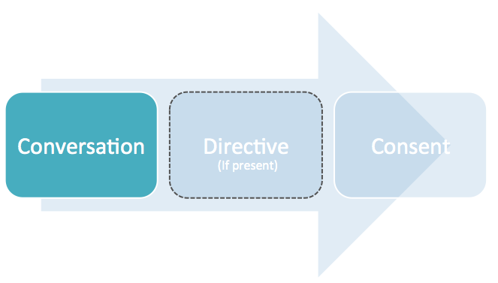
Conversation
Inform client of Reconnect privacy rights and consent practices:
What information is collected
How information is protected
Why and when information is shared

Slide 45
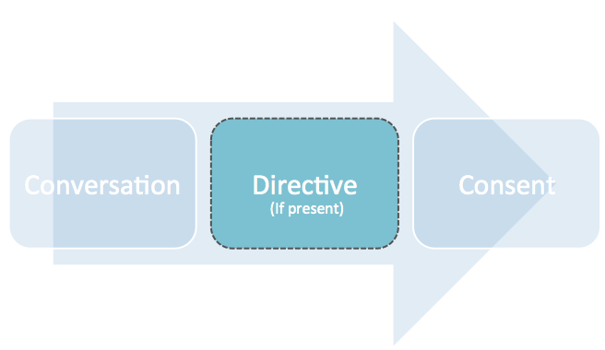
Directive
At any time a client can identify their desires about whom they wish to share or not share their information.

Slide 46
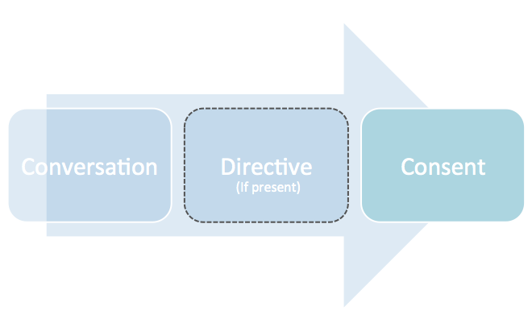
Consent
Where Express Consent is required, a consent form should be completed where possible. If express consent is given verbally this must be clearly documented in the client record.

Slide 47
Single consent form
Reconnect previously had 3 types of consent forms to allow for the release and sharing of Clients’ PHI:
Specific client consent
Circle of care consent
Consent for electronic sharing of assessment data (IAR)

Slide 48
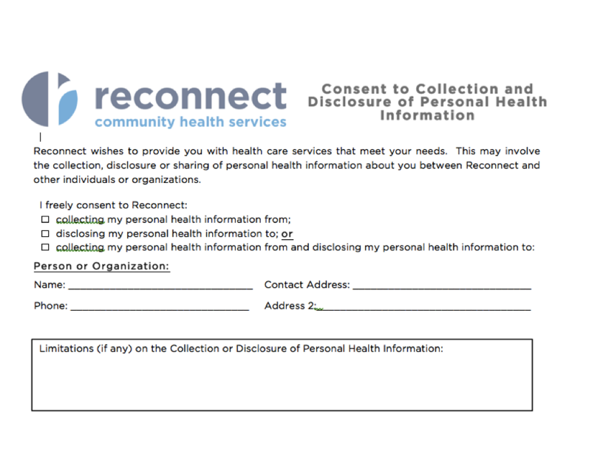
Consent to Collection & Disclosure of PHI

Slide 49
‘My privacy at Reconnect’ brochure

Slide 50
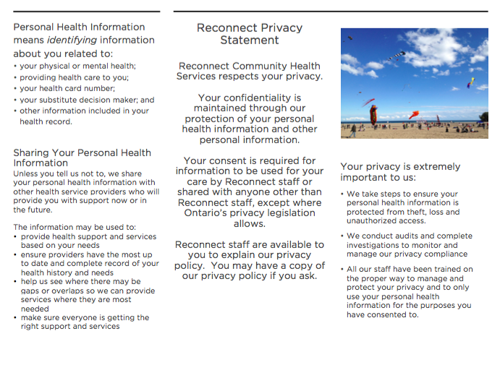
‘My privacy at Reconnect’ brochure

Slide 51
Staff response
Was not a hard sell
Response was positive
Organization wide education
Smaller group training on CMS
Privacy officer is available any time staff have questions
Tools – education manual, privacy policies, questions/answers, etc.

Slide 52
Tools for sharing
When consent to share is given (express or implied) within the circle of care, this can happen in a number of ways:
 | Fax
 | Courier
 | IAR
 | Next electronic sharing tool (CBI)

Slide 53
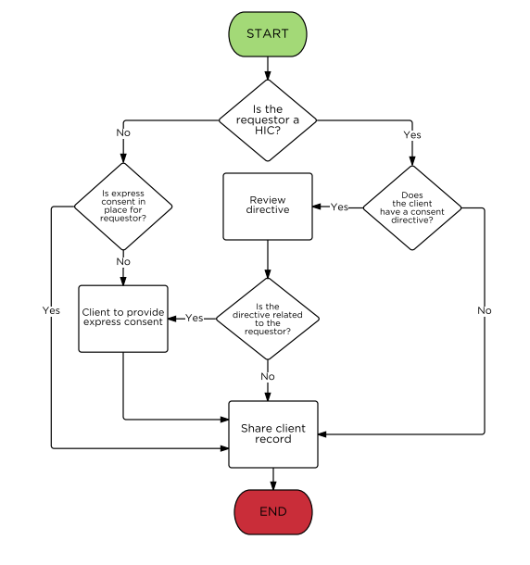
Express Consent Decision Tree

Slide 54
Questions?

Slide 55
Wrap-up
Website: www.ccim.on.ca
Contact Information:
Email: cmhcap@ccim.on.ca
iar@ccim.on.ca
55

