Slide 1
Data Quality:
Strategies to Support the Quality & Utility of OCAN

Slide 2
Agenda
Welcome
Objectives
LHIN shares work to promote Ontario Common Assessment of Need (OCAN) and Integrated Assessment Record (IAR) use
Lessons Learned from the Sector
OCAN Quality Toolkit
Health service provider (HSP) organizations share their approaches for supporting OCAN quality and utility to benefit service users

Slide 3
Objectives
  To learn about strategies LHINs and HSPs are currently using to:
    Monitor the quality of OCANs
    Utilize OCAN information in service delivery and planning
  To think about ways you may want to build on your current strategies
  To walk away with tools to put ideas into action

Slide 4
Champlain LHIN
Process to Support the use of OCAN and IAR
Presenter: Kevin Barclay
Date: January, 2016
Location: Webinar

Slide 5
Process for using reports and working with the sector
Convened an OCAN working group amongst providers, lead by representatives who work with OCAN and IAR regularly
  Initial focus was to develop approaches to collaborating on OCANs for common clients
  Renewed focus to explore IAR usage and dialogue about needs identified through OCAN
  LHIN review reports as they are provided
  Working group reviews highlights of reports as a group to identify opportunities to collaborate on improvements

Slide 6
Next Steps
Promote the benefits of exploring client identified needs as a way to improve services and systems
Explore with individual agencies the barriers to upload
Support the development of improvement plans to assist agencies in meeting MSAA obligations

Slide 7

Pathway to Engagement
Engage key informants
Collaborate on shared assessments
Obligate through MSAAs
Promote continuous development
Participate in the community of practice

Slide 8
Central LHIN Common Assessment and IAR Adoption Project Update
Karen Blackley, eHealth Program Manager
Central LHIN

Slide 9
Central LHIN CA & IAR Adoption Project – CSS Updates
Common Assessment and IAR Working Group (co-chaired by LHIN and CSS HSP)
  Working Group continues to meet on a regular basis
  Developed a detailed work plan to support Common Assessment and IAR adoption
IAR Trainer for the community sector has been hired by one of our HSPs
  support education and training for both the common assessments and the IAR has been hired
Roll-out of the AIS (Assessment & Intelligence Systems) and first pre-test has been completed by our HSPs
Notes:
Work plan includes items like:
Engaging with HSPs to better understand any challenges with the completing of CHA assessments, uploading of assessments and use of IAR as part of clinical work flows
Sharing of best practices on for Common Assessment and IAR to improve quality of assessments
Share of IAR and Common Assessment metrics with sector on regular basis
Implementation and use of the AIS to support education and training plans for HSPs, again to support quality improvements
AIS
First set of testing data gives us high level information on areas of the Common Assessment that our HSPs may need more training on

Slide 10
Central LHIN CA & IAR Adoption Project – MH&A Updates
LHIN recently attended our MH&A Network meeting to review the OCAN and IAR Operational Reports
  Commitment for ongoing dialogue with the LHIN on items such as use of IAR in business processes, consent practices, uploading practices
Look for opportunities for IAR Trainer to also support MH&A organizations with increase use of the IAR
Notes:
Early days with the MH&A engagement. We expect more to happen with the MH&A sector in fiscal year 16/17

Slide 11

Questions
Thank you Questions? Comments?
Central Local Health Integration Network
60 Renfrew Drive, Suite 300
Markham, ON L3R 0E1
Tel: 905-948-1872 or 1-866-392-5446
Fax: 905-948-8011
Email: central@lhins.on.ca
www.centrallhin.on.ca
Notes:
Closing Slide

Slide 12
OCAN Quality Toolkit

Slide 13
OCAN Quality Toolkit Details
Toolkit intent:
  Using real examples, the toolkit provides practical ways to improve the quality and utility of OCAN information
Toolkit measure of success:
  Interested HSPs “walk away” with a plan to implement at least one strategy around monitoring OCAN quality and using OCAN information to benefit consumers served
What’s in the toolkit:
  Framework
  Sector examples
  Worksheets

Slide 14
OCAN Quality Toolkit Framework

Slide 15
Input
Strategies to improve the quality of OCANs

Slide 16
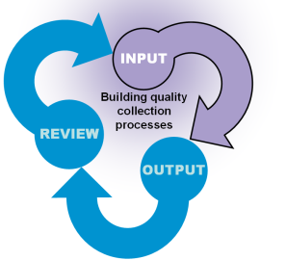






Input: Sector Strategies
One on One support
Consistent approach for
Documenting free text
Training using Case Studies
Using standardized reports
to identify errors
Forming a Committee
Process for OCANs to
Get done on time

Slide 17

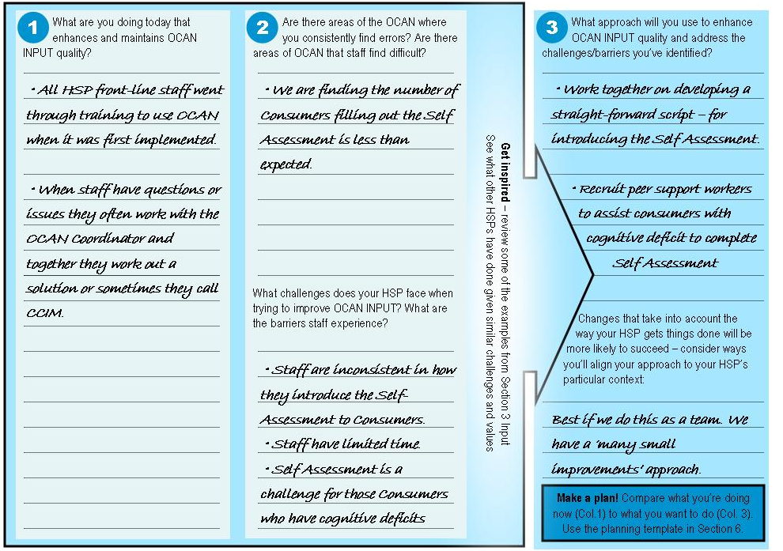
Input: Worksheet

Slide 18
Outputs
Identifying OCAN information that informs your quality efforts

Slide 19
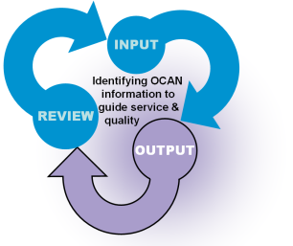



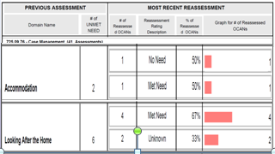
Output: Sector Examples
Optimal Referral | Specify | Actual Referral | Specify
Drop down list | Name of optimal referral | Drop down list | Name of actual referral
Priority | Domain | Action
 | Accommodation | Submit application for supported housing
  Key Demographics and Issues for HSP’s Client group
  Summary of Actions and Summary of Referrals
  Level of Agreement – Consumers and Staff
Accommodation
Food
Looking After the Home
Self Care
Daytime Activities
  Consumer Self-Assessment Completion Rate
  Areas of Need
  Change in Needs over Time

Slide 20
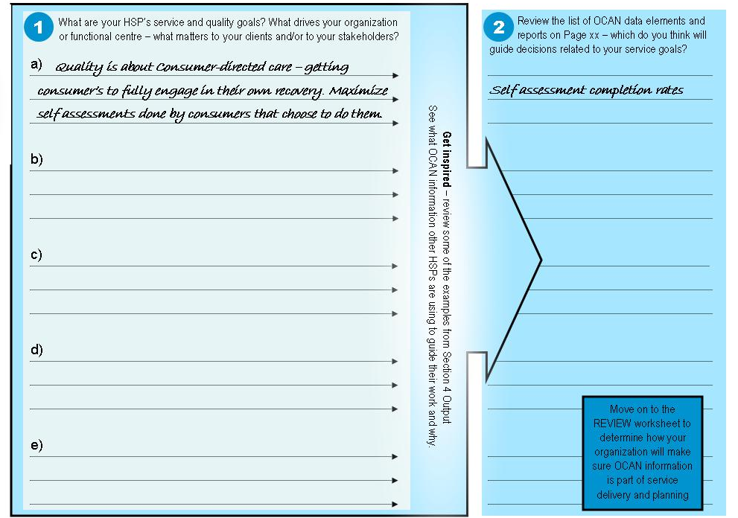
Output: Worksheet

Slide 21
Review
How do you review the outputs to contribute to improving service quality

Slide 22
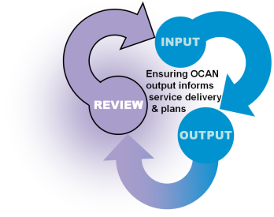
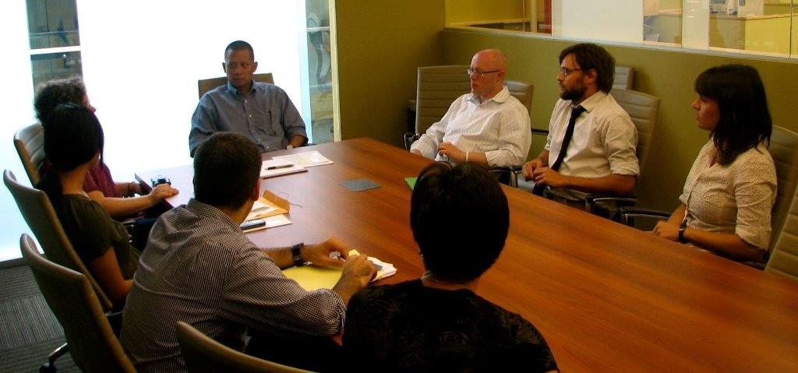
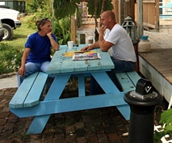
Review: Example Strategies
Gives examples of processes to regularly review the OCAN information to inform service delivery and decision-making
  Consumer/Worker Meetings
  Supervision Meetings
  Direct Service Team Meetings/Case Conferences
  Program Planning Meetings
  HSP Strategic Level Planning and Evaluation

Slide 23

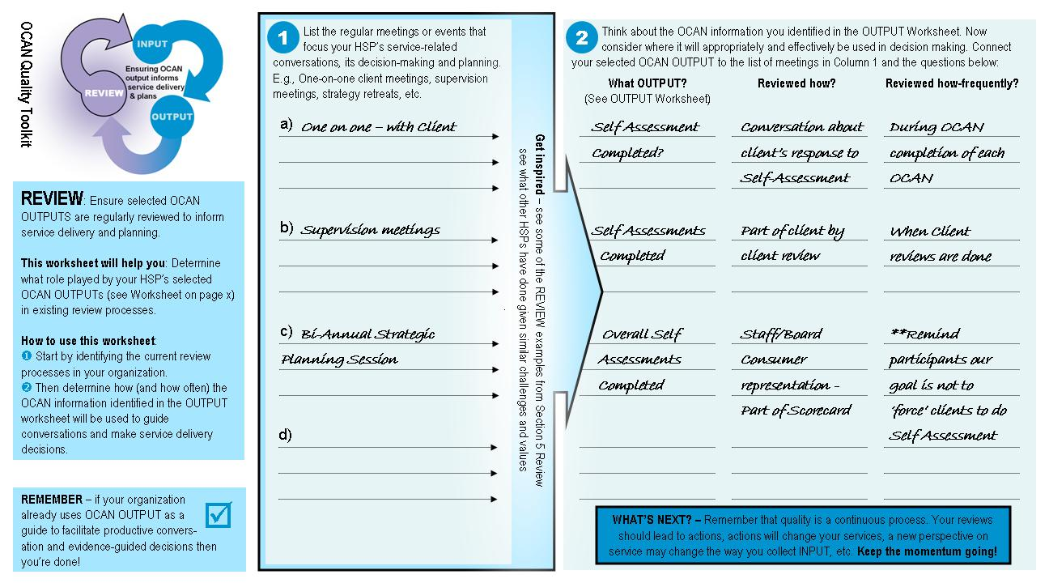
Review: Worksheet

Slide 24
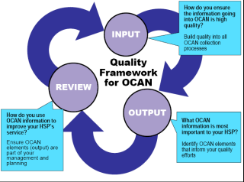
Where does it start?
You can start anywhere within the framework
Take an approach that fits with your organization’s focus and culture
Examples:
Summary of Actions used regularly – Output and Review
Planned refresher training– Input
Quality improvement working group meetings – Review

Slide 25
Section 6: Next Steps
Put a plan of action in place

Slide 26
Lessons Learned from the Sector
Summary from 2015

Slide 27
Lessons Learned from the Sector - 2015
Challenges | Lessons Learned
Sustaining the use of the Ontario Common Assessment of Need (OCAN) tool to support client care applying OCAN to support clinical benefits engaging consumers in the assessment process seen as a paper exercise/administrative task | Review and modify approach Champions/Mentors Communication Plan Supportive working environment Standard script to inform consumers Use OCAN information in practice Highlight OCAN research – positive client outcomes
Maintaining the standards and data quality of the assessment information entered in OCAN | Training strategy OCAN coordinator/working group Use of OCAN Quality Toolkit OCAN quality audit reviews Use of OCAN reports

Slide 28
Lessons Learned from the Sector – Cont’d
Challenges | Lessons Learned
Maintaining reassessment schedule for OCAN and incorporating it into the daily workflow | Use of tools to ensure 6 month time frame is followed (e.g. email reminders) Use approaches that are efficient and focus on clinical value of client reviews
Using the OCAN individual assessment reports and HSP standardized aggregate reports to support service delivery and quality improvement planning | Process for accessing reports Determine priority outputs to review Process for reviewing reports
Maintaining Technology in order to enter OCANs electronically, upload to IAR and access reports challenges using IAR challenges using HSP Software | Ensure OCANs are uploaded to the IAR HSPs maintain IAR user accounts Process to address IAR technical issues Work with vendor to do periodic updates to improve efficiency and customize reports

Slide 29

Strategies to Support OCAN Quality and Use
Jonathan Hewitt

Slide 30

Background
CMHA-Haliburton, Kawartha, Pine Ridge Branch
CMHA branch provides services to clients over a large geographic region
All staff and managers have been trained in the use of the OCAN tool
OCAN is used in many different programs & services
Clients’ first OCANs are completed at intake to help determine appropriate service type

Slide 31
Strategies used to Sustain the OCAN
Getting “Buy In” from all stakeholders
Established an OCAN Oversight Committee
Include OCAN discussions in team meetings
Action items generated from OCANs are provided as part of the client case transfer to appropriate service
Common software for OCAN improved sharing and coordination across programs
Regular audits of OCANs and follow-up as needed

Slide 32
Strategies to Ensure Quality of OCANs:
Training and On-going Support for Staff
Customize Training Materials:
  Created a Domain Reference Guide unique to our community – *don’t get stuck on “anchor questions”
  Produced a 4 hour OCAN Training Video
Deliver training sessions for new staff and refresher training for existing staff
Have OCAN mentor/trainer available for “on the job” support for staff

Slide 33
Using OCAN to support client care
OCAN is a really good framework- adjust approach to using OCAN to fit specific client and service type
Highlight at the start that this is a valuable evidence-based assessment tool to support client care
OCAN identifies, more rapidly, which individuals are appropriate for our services and which other services in the community would best fit their needs
Use OCAN information to develop actions and monitor treatment plans
Use OCAN reports to support decisions that have positive impact on clients

Slide 34
Challenges Resolved
Challenges | Resolved
OCAN initially used as a tool to collect data | OCAN now used to create treatment/service plans for clients Using OCAN as a valuable evidence-based assessment tool
Need to triage individuals into appropriate services | OCAN assists with client referrals to community resources Connects clients faster and more efficiently with the right services both externally and internally
Time to complete OCAN Reassessment | Software auto population feature reduces length of time for reassessment
Challenges for youth accessing adult services as they transition from other youth programs | Trained staff from other youth agencies to utilize the OCAN for transitioning youth from their services to adult programs

Slide 35
Current Issues
Wide variance in the comprehensiveness of completed OCANS among HSPs
For individuals that have chronic mental health symptoms (e.g. psychosis), completing the OCAN can be problematic depending on their level of wellness
More valuable if OCAN was used across the entire MHA services so that everyone ‘speaks the same language ’ for service provision

Slide 36
Key Tips for Success- OCAN
Make sure you have staff buy in
Allow the tool to be used to its fullest extent
Adapt approach to using OCAN to fit your particular organization’s needs and culture
Review the actions and create comprehensive comments in the OCAN to maximize clinical utility
Utilize software generated OCAN Reports to enable you to compare the levels of need change over time.

Slide 37
Questions or Comments
Jonathan Hewitt
CMHA-Haliburton, Kawartha, Pine Ridge Branch
jhewitt@cmhahkpr.ca
(705)748-6711 Ext. 2028

Slide 38
Strategies that Support OCAN Quality and Use
University Health Network
Faith Vermeer

Slide 39
Background
UHN began using OCAN in 2012
UHN uses OCAN in all recommended outpatient mental health services
Focus in this presentation on strategies used in the Assertive Community Treatment Team (ACTT)

Slide 40
Strategy to maintain the quality of OCANs: Training
OCAN trainer provides:
Training course for new staff
IAR training
Informal refreshers during monthly business meetings
One on one support as needed

Slide 41
Strategy to support the quality of OCANs: Business Meetings
The ACT team has monthly business meetings
OCAN is a standing agenda item at the meetings
Opportunity for staff to raise any issues and ask questions related to OCAN
Plan to review parts of the OCAN. E.g. discuss ratings of 1 or 2 domains per meeting to ensure consistency in scoring

Slide 42
Strategies for maximizing the clinical value of OCAN
For new clients, view latest OCAN on IAR to have more of a history and build on client’s story
Use OCAN to support the engagement process
Promote the self assessment as a way to capture the Client’s voice
When clients express no goals, use the self assessment to discuss identified unmet needs and begin goal planning
Use OCAN information in treatment planning, assessing goals and reviewing progress

Slide 43
Presenting OCANs at weekly treatment planning meeting
6 month OCAN reassessments are scheduled to coincide with the treatment planning schedule
Email reminders for OCAN reassessment due dates are sent out to staff
Use treatment planning to complete outstanding OCANs and new intakes
Discuss any urgent issues and use OCAN to create action plan
View client history and review/complete current OCAN
Allows us to view progress/strengths/goals

Slide 44
Questions or Comments - UHN
Faith Vermeer
University Health Network
Faith.Vermeer@uhn.ca
416-603-5800 ext. 8197
44

Slide 45
Strategies to support OCAN quality and use by CMHA
CMHA Champlain East
Kim Height

Slide 46
Background: Use of OCAN at
CMHA Champlain East
Early adopter of OCAN
OCANs in our functional centres
OCAN is completed by the staff assigned

Slide 47
Strategies to maintain the quality of OCANs
2 key approaches:
Regular Training
OCAN Working Group

Slide 48
Training
Peer to Peer Training
Annual refresher training for staff at team meetings
Goal: To keep everyone fresh on the information to promote accuracy and consistency

Slide 49
OCAN Working Group
Purpose:
To support staff in completing high quality OCANs and using the information to enhance client care
Members:
Front line staff from various offices
The manager representation is the OCAN coordinator
Structure and Process of the meetings:
Meet every six weeks to discuss issues that are raised by their peers
Determine if additional training is needed and develop training approach
Iron out issues at the meeting and provide consistent direction to staff
Review OCAN reports during the meetings

Slide 50
OCAN Working Group – Cont’d
Activities:
Provide refresher training for existing staff
Train new staff
Work with supervisors
Leads are mentors whom staff can approach with OCAN questions

Slide 51
Using OCAN to support client care- strategies
Emphasis on importance of capturing the client’s perspective
High percentage of clients willing to complete the self assessment and consent to having OCAN shared in IAR
OCAN is used to support good conversations between staff and client
Approach to using OCAN helps build the rapport between staff and clients
Opened up doors to some helpful questions that staff might not have asked before
OCAN used to develop and monitor client service plans

Slide 52
Challenges Resolved
Challenges | Resolved
OCAN initially perceived as clerical task that will take away from direct service | -staff have found a flow that supports direct service - develop service plans with clients
Initially thought to use OCAN at intake to determine eligibility was not a good fit in our organization | - decided better for us to complete OCAN once client assigned to program
Initial procedure to complete first OCAN within 30 days was unrealistic | Decided to add more flexibility by extending to up to 60 days
Concern that entering information electronically would have negative impact on rapport building | made laptops and tablets available and, with practice, staff saw that it saves them from extra clerical work

Slide 53
Current issues regarding OCAN
6 month reassessment timeframe
Some other HSPs in the area are not using OCAN
Completing OCANs for clients who we are not able to contact

Slide 54
Key Tips for Success
Getting Buy In at every level of the organization
Approach to using OCAN that supports the direct service work
OCAN mentors to do “on the job” training and support
Emphasis on client perspective captured in OCAN
Regular meetings with lead staff
Ongoing training to staff

Slide 55
Questions or Comments- CMHA
Kim Height
CMHA Champlain East
613-933-5845 ext. 243
heightk@cmha-east.on.ca

Slide 56
Questions or Feedback
If you have any questions or comments, please contact:
        Project Support Centre
        Website: www.ccim.on.ca
        E-mail: cmhcap@ccim.on.ca

