Slide 1
Ontario Common Assessment of Need (OCAN) Training:
Self-Assessment Component

Slide 2
Objectives
Increase understanding about:
  The research related to the Consumer Self-Assessment
  The purpose and elements within in the Self-Assessment
  How to introduce the Self-Assessment to a client
  How to engage a client/consumer in conversation prompted by his\her responses in the self-assessment

Slide 3
OCAN Self- Assessment

Slide 4
CORE + Self OCAN
The CORE + Self OCAN consists of the Consumer Information Summary elements, the Consumer Self-Assessment and the Mental Health Functional Centre Use

Slide 5
Benefits of the Self Assessment
Gives consumers a voice by capturing Their perspective
Clients identify their own needs
Supports a client driven approach to service planning and delivery

Slide 6
Recovery

Slide 7
OCAN and Recovery Principles
  Values Empowerment
  Consumer perspective and input is central to information gathered in OCAN and the determination of priority areas to work on.
  Values and Elicits Hope
  The OCAN tool includes open ended questions where consumers share and later discuss hopes and dreams.
  Values Self Determination
  OCAN focuses heavily on consumer-voiced needs, through the assessment of 24 concrete life domains.
  Works Toward the Elimination of Prejudice and Discrimination
  The OCAN approach views a consumer as a whole person and an active participant in the assessment process, not as a diagnosis (“patient”)
  Values Meaningful Choice
  Consumers engage with their workers to focus on their perspective in
  preparation for action and service planning.
  Based on recovery principles from the Self Help Alliance of Waterloo Wellington Dufferin

Slide 8


Using an Evidence-Based Tool:
CANSAS-P
Research
Findings
What this means for services
Meeting client identified unmet needs* improves outcomes in:
Well-being
Therapeutic alliance
Satisfaction with services
*converting unmet need to met need or no need
The process of regular reviews with
clients improves outcomes
Service plans and activities should focus on addressing client identified unmet needs
Use 6 month reassessments as a time to get your client’s perspective on their progress and current areas of unmet need

Slide 9
Introducing the Self-Assessment to Clients

Slide 10
Introducing Assessments
What is an “assessment”?
An assessment is process that guides our conversation about your strengths and areas where you need help. This helps us understand the kind of support you want from our service.
Introducing OCAN – Resource:
OCAN Brochure for consumers/clients

Slide 11
Informing clients of their privacy right and your consent practices
Your organization may decide that this is an appropriate time to provide this information
Inform client of their privacy rights:
  What information is collected
  How information is protected
  Why and when information is shared
  *This will be part of the Privacy, Security and Consent Management Training session
  *For the purposes of this training, we will leave this part out and focus specifically on introducing the OCAN tool

Slide 12
Introducing the Self Assessment
Self assessment is optional
Complete the parts you feel comfortable with
Helps me understand areas of your life where you need support and where things are going well
Gives you a voice by capturing your perspective
Would you like support to complete it?
Reassessment
Review progress and next steps
Use last self-assessment and make changes

Slide 13

Covers 24 Domains: Identifying Areas of Need
Benefits
Accommodation
Food
Education
Transportation
Sexual
Expression
Looking After
the Home
Other Dependents
Self-Care
Daytime
Activities
Child Care
Communication
Psychotic
Symptoms
Physical
Health
Money
Safety
to Self
Intimate
Relationships
Company
Psychological
Distress
Other Addictions
Drugs
Information on
condition and treatment
Alcohol
Safety to
Others

Slide 14
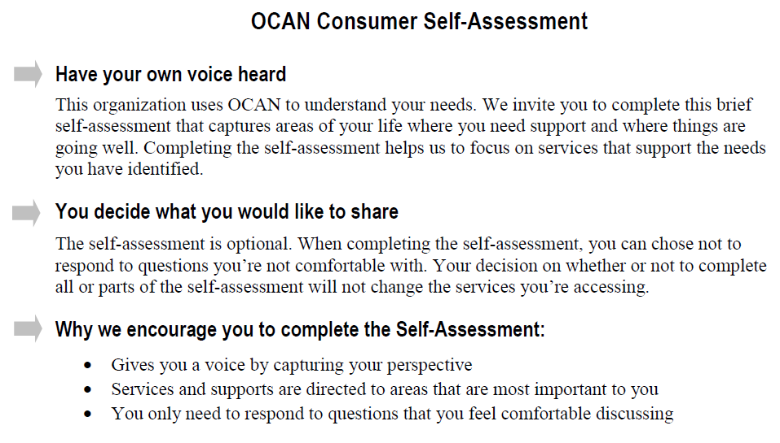
Consumer Self-Assessment
This introduction is at the front of the self-assessment form. Use this information to introduce the self-assessment to the client

Slide 15
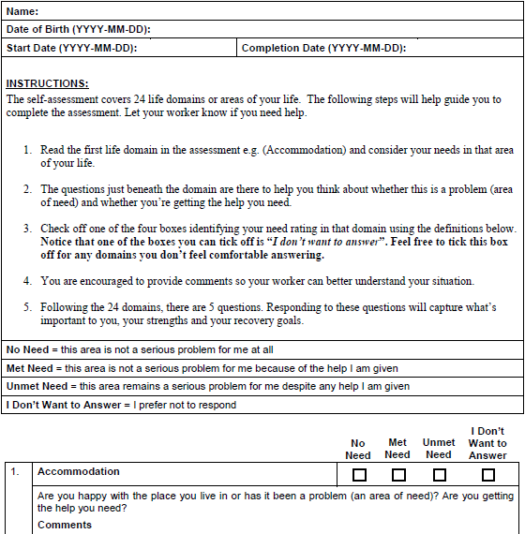
Consumer Self-Assessment: Instructions
Review instructions with your client
Rating need

Slide 16
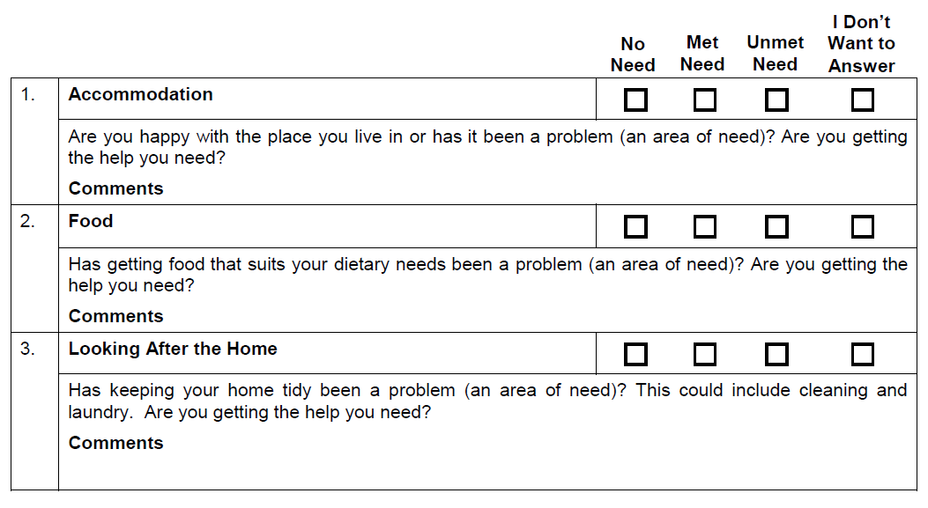
Consumer Self-Assessment trigger questions…
Explain the purpose of the Trigger Questions

Slide 17
Consumer Self-Assessment Guide
Resource Material: One Page Guide
Completing the self assessment can give you a voice in identifying areas that have been a problem (or area of need) in your life over the past month.
This information is used to guide conversations with your worker and focus services on your needs
Below are the definitions of the “Need Scale”
Not a Problem – going well NO NEED | Not a problem – because I get help MET NEED | This is a problem UNMET NEED | Not interested in discussing this I DON’T WANT TO ANSWER

Slide 18
Steps to help guide the consumer
  For each of the 24 domains, think about whether you have a problem in that area of your life
  The question is a “jumping off point” for you to think about that area of your life in general
  The question is not meant to be answered literally
  Check off one of the four boxes
  Provide comments to explain your choice if you want
  Here are examples of the purpose of some of the domains (see next slide)

Slide 19
Intent of these domains is to determine:
Communication | If you have access to a telephone, computer (internet) or other means of communication.
Company | If you have social contact with family and/or friends
Intimate Relationships | If you have very close relationships with a partner, family member and/or friend
Sexual Expression | If you are satisfied with your sex life and sexual health

Slide 20
Consumer Self-Assessment
Additional Questions
Recovery Focused Questions
What are your strengths and skills?
What are your hopes and goals for the future?
What do you need to accomplish your goals?
Is spirituality/religion an important part of your life? Please explain
Is culture (heritage) an important part of your life? Please explain

Slide 21
Susan’s Story
Susan Marshall: Community Mental Health Sector and Use of OCAN

Slide 22


3a. Do you think your clients may need support to complete the self assessment? Yes or No
3b. If yes, what are some of the reasons?
  Free text answer

Slide 23
4. Who would you see providing this support in your organization if it’s needed by the client? (select all that apply)
Worker
Another worker
Peer
Family member or friend
Other

Slide 24
Your process for client’s completing self Assessment
What to consider:
When to introduce OCAN to client
  As early as possible
  Where client completes the self-assessment
  In organization’s space
  In their home
  What method should you have clients use?
      On paper
      Computers

Slide 25
Doing the Self- Assessment at The Reassessment Cycle

Slide 26


Experience With Reassessments
Alpha Court Community Mental Health and Addiction Services
Nicole Latour
nlatour@alphacourt.ca

Slide 27

Consumer Self Reassessment:
Challenge
Having clients complete the self assessment at the time of reassessment

Slide 28

Consumer Self Assessment:
Strategies
  Staff communicate messages that highlight a client centred approach:
  You own your assessment
  It’s important to capture your voice
  Highlight what you have accomplished
  Focus on what you identify as your current needs
Offer client ways to facilitate their completion of the self assessment:
  Option to enter it directly on the computer and block access to other parts of the computer system
  Refer to the last OCAN so you’re not starting from scratch. E.g. give the client their last self assessment and ask them to circle what has changed
  If required, arrange support of someone client feels comfortable with e.g. family member, student, worker

Slide 29

Assessment Conversation
Engages the person with lived experience and the person with assessment knowledge in a conversation focused on the consumer’s strengths, challenges and goals for recovery.

Slide 30
The Assessment Conversation
Introduction
Tips for a successful assessment
conversation:
Provide a safe space
Allow the conversation
to unfold naturally
Explore variances
Summarize key points
OCAN Consumer
Self-Assessment
Conversation
OCAN Staff
Assessment
I have a voice
I hear you loud and clear

Slide 31
The Conversation:
Use your client’s responses in the self-assessment to guide the conversation
Do not treat it like a “paper survey”. It should be a natural conversation
Ask your client to elaborate on areas where they’re experiencing problems (unmet need) and areas where they have strengths (met need and no need)
Use an approach that fits:
  your style of practice
  where the consumer is at
  the context of the service
Do not encourage your client to change responses.

Slide 32
Homework
Consumer Self-Assessment Practice!
Complete an OCAN Self- Assessment on yourself
Resource Materials:
OCAN Self Assessment Form

Slide 33
Homework continued..
Using the resource materials provided, create a script for introducing the OCAN Assessment that fits with your organization’s culture

Slide 34

Any questions?

