Slide 1
IAR Business Process
Developing a process for using IAR to support your work with Clients
IAR Business Process

Slide 2


What best describes your role(s) in your organization?
Direct Service Staff
Trainer
Manager
Administrative Staff
Other

Slide 3

Do you currently use IAR in your work?
Yes
No

Slide 4
Webinar Agenda
Overview
Benefits of using the IAR as a viewer
Tools to support the development of a process/procedure for using IAR to support client care
Case Studies of Health Services Provider (HSP) organizations’ procedures for IAR use
5. Next Steps: develop or review your procedure for IAR
Notes:
procedure

Slide 5

Why a session on developing a process/procedure for using IAR?
Lessons learned from past implementations:
Regular use of IAR provides access to client assessments to inform the service you provide to your clients
Health Service Provider (HSP) organizations that find the most value in IAR have incorporated the use of IAR as part of their work flow
Regular Use of IAR
Implement IAR
Notes:
HSP organizations put time and effort into implementation. In order to realize the benefits, it’s essential to take the step of developing a procedure for using IAR

Slide 6
Benefits of IAR

Slide 7
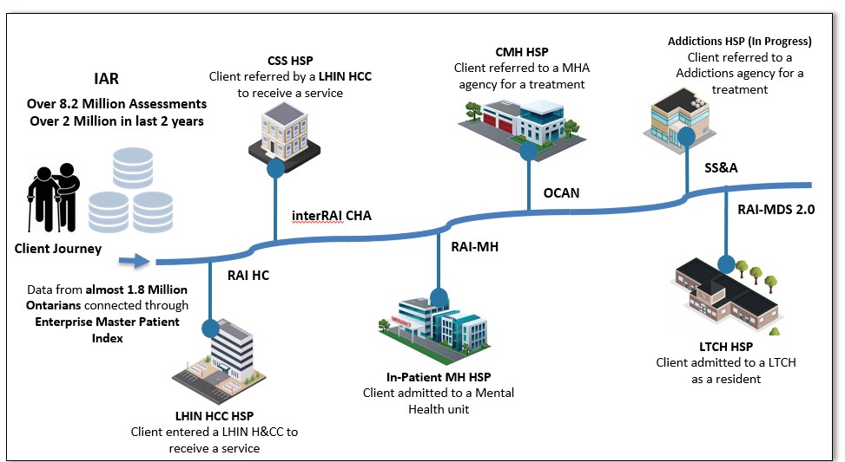
    Using IAR to understand the Client journey
The IAR Data set can tell us about the Client Care Journey. Client assessments data is captured and uploaded in IAR from across the continuum of care.
Notes:
-identify and create a stakeholder distribution list – talk to HCCB

Slide 8

Benefits of IAR
Benefits of IAR
Promotes a client centered approach
Ensures secure access to client information
Informs care plan
Improves coordination across the circle of care
Contains a wealth of data for service & systems planning
Notes:
Slide Presenter: CCIM
Core focus of IAR is to promote a client-centered approach by…ensuring secure access to client info (e.g., when and where they’ve had an assessment completed)…which further supports development of the client’s current care plan….and ultimately aims to improve coordination across the client’s circle of care.
With the various assessments supported through IAR, there is also the additional benefit of a wealth of data that can be used to inform both service planning at the organization level, as well as system planning for LHINs and other system leaders.

Slide 9
Comments from HSPs using IAR
  “Using IAR makes it easier to exchange information between health care providers. It improves efficiency by saving
  clinicians time they spend tracking down information”
  Canadian Mental Health Association (CMHA) __
“The IAR allows staff to have more of a history and build on the client’s story. It improves coordination across the client’s circle of care.”
University Health Network (UHN)

Slide 10
IAR: Easy access to information, why not?
Sector | Common Assessment | Accessible Information | Example
Addictions | Staged Screening & Assessment (SS&A): 3 Screeners & GAIN Q3 MI ONT | Screeners identify addictions and mental health issues. Recommendation and Referral Summary (Q3RRS) outlines evidence-based treatment recommendations based on problem severity and service utilization. | Stacey’s work and education has been affected by her addiction. She has missed quite a few days in her part-time job and her grades are declining.
Community Mental Health | Ontario Common Assessment of Need (OCAN) | Client needs in a range of psychosocial determinants of health are rated by “No Need”, “Met Need” and “Unmet Need”. | Stacey uses alcohol daily and symptoms of anxiety prevent her from socializing. The OCAN identifies unmet needs in the domains of “Alcohol” and “Psychological Distress”
In-patient Mental Health | RAI – MH | Reason for client’s admission to hospital and their status at discharge to support the transition back to the community | Stacey was admitted to hospital after expressing thoughts of suicide
Community Support Services | interRAI PS, interRAI CHA | Level of functioning and service required to support client’s activities of daily living | Stacey requires support with meal preparation
Home and Community Care | interRAI CA, RAI-HC / interRAI-HC | Level of functioning and service required to support client’s activities of daily living | Stacey needs assistance with medications
Long Term Care Homes | RAI – MDS 2.0 | Level of functioning for elderly clients living in long term care homes | Stacey is independent with dressing and bathing

Slide 11
Understanding the Client’s story (Q3RRS)
Betty
17 years old, referred for addictions counselling
Summary of status:
  Pregnant
  low attendance and grades at school
  regular use of alcohol and marijuana
  symptoms of depression and anxiety
Summary of Recommendations:
  Referral for pre-natal care and new mother’s group
  Review Betty's progress in current services related to substance use problems and explore options for more intensive services to reduce increased risk related to pregnancy
  Referral to CBT for depression and anxiety

Slide 12
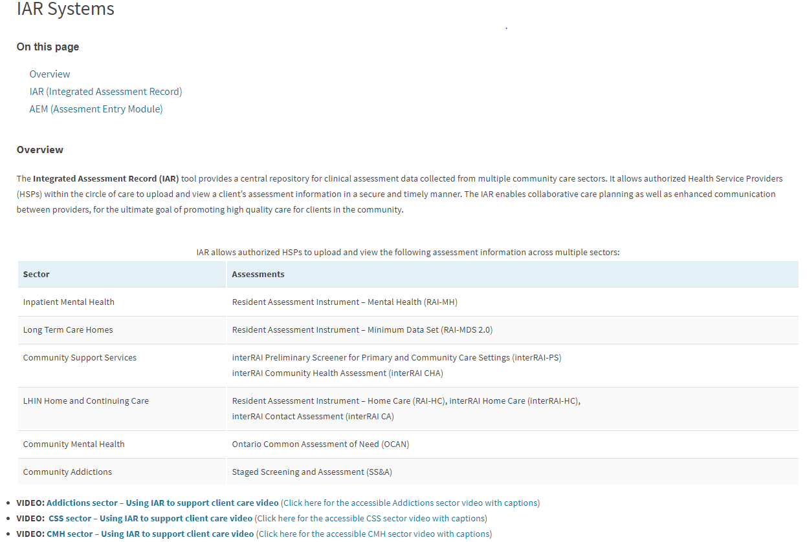
Videos: Mock Client Scenarios
Click HERE to access three 10 minute videos on examples of using IAR
*Once you’re on the CCIM website, scroll partway down the screen and click here to start the videos

Slide 13

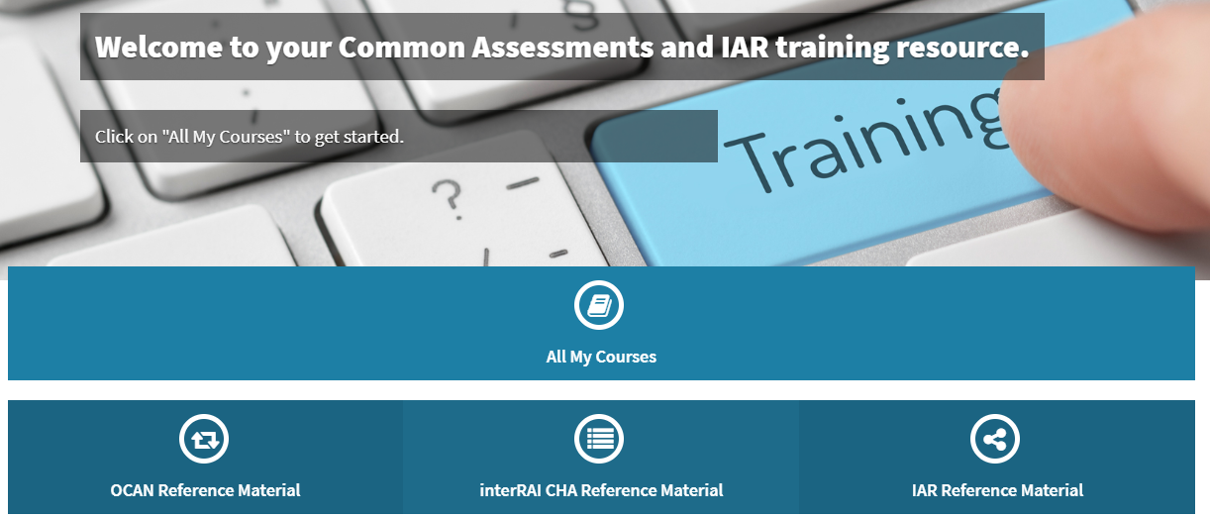
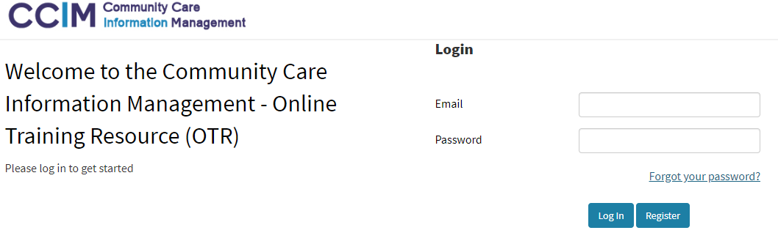

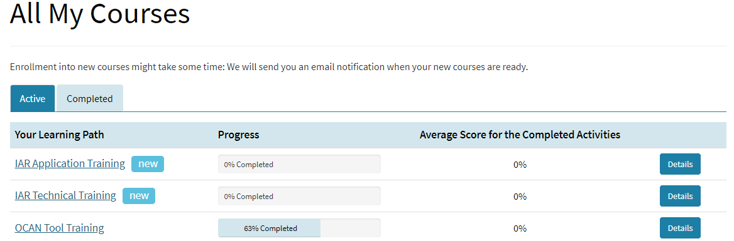
Making Training Easier: Self-Directed eLearning
Click HERE to access new interactive eLearning
Tip: use Google Chrome

Slide 14
Developing a process for IAR Use

Slide 15


What is a Business Process?
A series of connected tasks that, once completed, achieves a goal

Slide 16
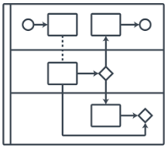
Tools to help develop processes/procedures
Business Process Mapping
Business Process Chart
Task | Who/Role | Document

Slide 17


What is the goal for using IAR?
To learn about the client and their interactions with other services to inform your work and improve the client’s experience

Slide 18
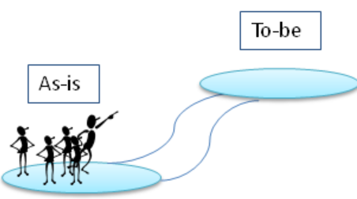
How do you develop a business process for IAR use?
To be
Identify where the use of IAR best fits in your work flow
Determine your current process for gathering client information from external organizations
As-is

Slide 19
Business Process Mapping
A method that can be used to map a business process
Has a starting point and an end point
Set out the beginning and end tasks
  Then ask … “And then what”?
  Consider tasks, decisions and roles
  Note any bottlenecks / barriers separately – which parts least benefit the client
Task
ROLE
Decision

Slide 20
Are you familiar with business process mapping?
Yes
No

Slide 21
How to map a Business Process
The following symbols are commonly used in a Business Process Map:
Activity/Task
Start
Decision
Direction of flow
Form/document
End

Slide 22
Business Process Mapping example
Scenario 1: Wake up in the morning and go to work
Activity/Task
Decision
Form/document
Start
Direction of flow
End
Notes:
“A picture is worth a thousand words”

Slide 23
If Business Process Mapping is not your “thing”
Use a Business Process Chart:
Another method that can be used to describe a business process
Uses a chart to identify each task, the role responsible and the form/document used (if applicable)
  Scenario 2: Get to work and prepare for your morning meeting
  ”
Task | Who/Role | Form/Document
Print Agenda | Team Leader | Agenda
Make Photocopies of the agenda | Administrative Assistant | Agenda
Prepare the Coffee | Administrative Assistant
Record Attendance | Staff member | Attendance Sheet
Review the agenda with the team | Team Leader | Agenda

Slide 24
An HSP’s procedure for using IAR with new and existing Clients
Business Process Maps
Business Process Chart

Slide 25
Procedure for a new Client

Slide 26
Using IAR in
Assertive Community Treatment (ACT) TEAM
Sharon Blom

Slide 27
New Client Example
Ne
New Client: Melvin, is referred to ACT
  The Intake worker searches on IAR and finds an OCAN completed by a previous organization working with Melvin
    The intake package identifies Melvin, does not speak English, has a diagnosis of schizophrenia, is on ODSP, is paying market rent, and has serious physical health issues.
  This information helped the clinician to:
    Book an interpreter quickly for an initial intake meeting
    Begin work on pressing financial and time sensitive medical goals

Slide 28
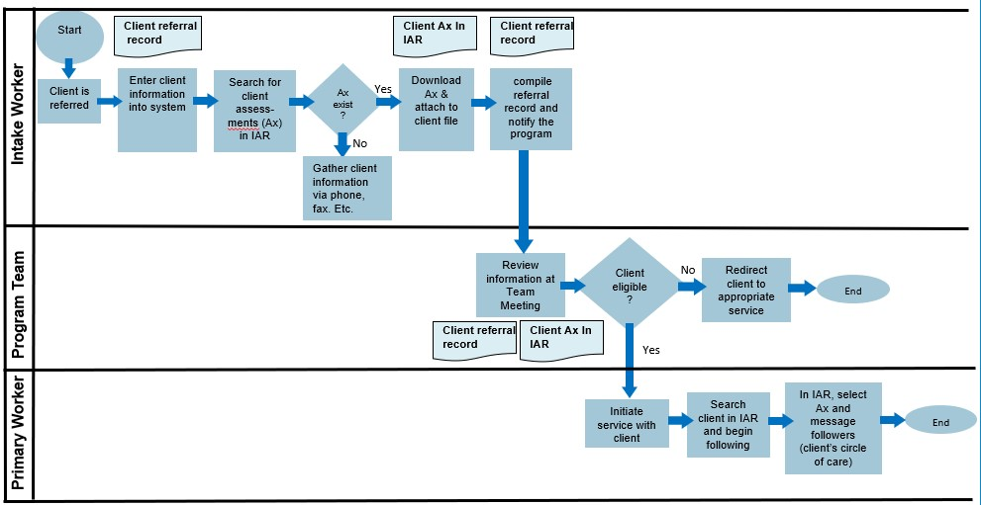

Business Process Map:
Using IAR for a new Client
CMHA
Notes:
Could be an addictions worker and not an intake worker (common in CMH – for it to be mental health worker) Developed a process that builds on existing client information
At Intake – we search IAR for the latest OCAN (for new clients that have had an OCAN completed by another organization)
In the first month, that OCAN is reviewed during treatment planning and a new OCAN is started with team input.
The assessment accessed through IAR provides the team with a recent history and allows the team to build on the client’s story.

Slide 29
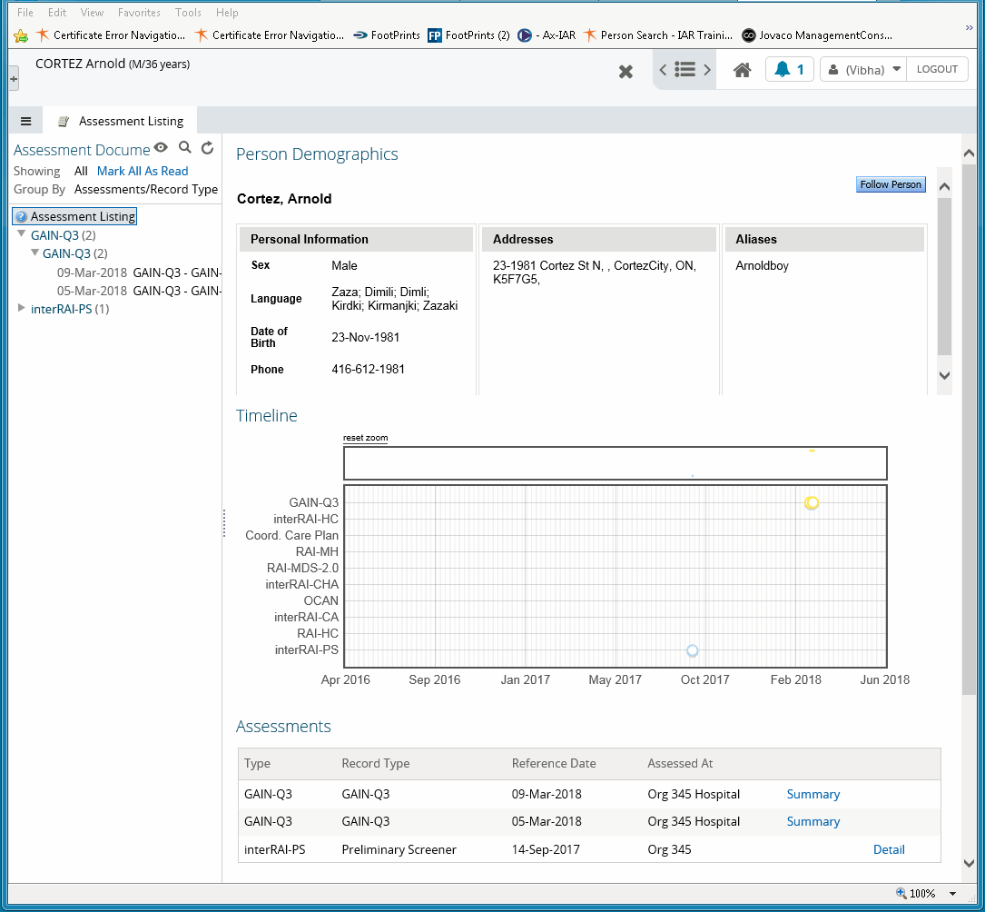


Follow / Unfollow a person
To follow a Person:
Verify that you are viewing the correct person
Click the Follow Person button
To Unfollow a Person:
Click the unfollow Person button
1
2
3
Notes:
You can choose which assessments you want to follow a client for your client – you need not follow all the assessments for your client if you don’t think they are as relevant or want notifications for.

Slide 30
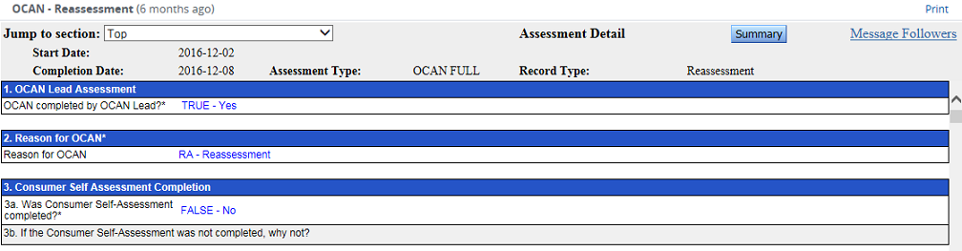
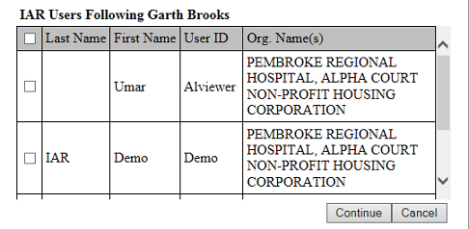
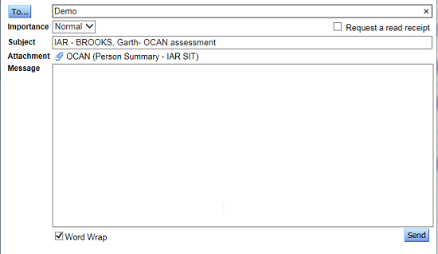
Messaging from within an assessment
To message followers from within an Assessment:
Click the Message Followers button
Select the followers to message from IAR Users Following list
Click Continue
Type your message
Click the Send button
1
2
4
3
5

Slide 31
Business Process Chart:
Using IAR for a new Client
Tasks | Who | Document
Client is referred: Enter client information into system | Intake Worker | Client referral record
Search for client assessments (Ax) on IAR | Intake Worker
Download client’s Ax from IAR and attach to client file | Intake Worker | client’s Ax in IAR
Compile the referral record and notify the program | Intake Worker | client referral record
Review information at Team Meeting to determine eligibility | Team Members | client’s Ax in IAR and client referral record
Eligible: initiate service | Primary Worker
Search client in IAR and begin following | Primary Worker
In IAR, select Ax and message followers (client’s circle of care) | Primary Worker
CMHA

Slide 32
Procedure for an existing Client

Slide 33
Existing Client Examples
Existing client, Susan, is hospitalized
The service provider receives a notification that a new assessment is available. The service provider checks IAR and finds a interRAI HC completed while Susan was in hospital – the common assessment completed by Home and Community Care (H&CC). The assessment identifies that:
  Susan had a stroke. She can walk independently, but requires support with ordinary housework and meal preparation.
  Susan will receive physical and occupational therapy
  Susan’s mood has deteriorated – increased symptoms of depression
This information helped the service provider to:
  Connect with the H&CC worker and inpatient social worker to collaborate on a discharge plan from hospital
  Consider the impact that her physical health condition can have on her mental health
Notes:
Addictions worker

Slide 34
Business Process Chart:
Using IAR for an existing client
Tasks | Who | Document
Notification of an update in IAR | Service Provider | Email
Log into IAR and check messages | Service Provider
Click on Ax attachments link within the message | Service Provider
View Ax in IAR | Service Provider | Client Ax in IAR
If required, contact other HSP using IAR messaging or phone | Service Provider
Review/revise service plan based on Ax accessed through IAR and coordination with other HSP | Service Provider and client | Client service plan
CMHA

Slide 35
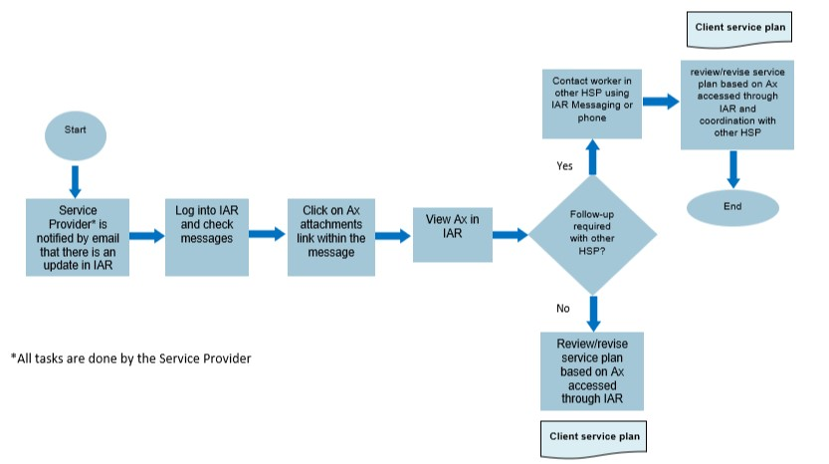
Business Process Map:
Using IAR for an existing Client
CMHA

Slide 36
Which format do you think you’ll use to represent your “As Is” and “To Be” Business Process?
Business Process Mapping
Process Chart

Slide 37
Develop your procedure/process for integrating IAR use into your workflow

Slide 38
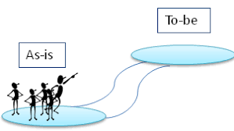
Document your “As Is” and “To Be” process to incorporate the use of IAR
Use the template provided to complete your “As Is” and “To Be” business process maps or charts
  Involve a variety of members of your team
    Consider: what are the steps, who does what, decision points
  Finalize your “ To Be” business process
  Document and communicate process to relevant staff
Client Type | Starting Point | End Point
1. New Client | New client is referred | Service is initiated or client redirected
2. Existing Client | Receive email notification of update in IAR | Review/Revise service plan based on Ax viewed in IAR
  Do not expect perfection right away. This is an evolving process!

Slide 39



Reviewing your workflow
Interactive team building
Come up with innovative ideas
Opportunity to make changes that benefit staff and clients
Notes:
Putting a lot of effort into IAR and putting it in your workflow maximizes your use of IAY

Slide 40
Think about the roles in your organization. Who would you include in this activity?

Slide 41
Recap:
Developing a process/procedure for using IAR
Regular Use of IAR
Implement IAR
Notes:
HSP organizations put time and effort into implementation. In order to realize the benefits, it’s essential to take the step of developing a procedure for using IAR

Slide 42
Q&A
Additional feedback and questions can be sent to the CCIM service desk at servicedesk@ccim.on.ca
Please take a few minutes to complete the brief survey that will be shared with you shortly.

